Slide 1

How the grid works

Slide 2
Agenda
Agenda
9.30 Welcome and introductions
9.40 Introduction to DNOs
9.55 Structure of the grid
10.15 How we manage grid capacity
10.35 Break
10.50 New connection applications
11.15 Generation connections case study
11.40 Heat maps
12.00 The future
12.15 Lunch and opportunity to talk to ENWL colleagues about your schemes and plans
14.00 Close

Slide 3
Introductions
  What is your experience of grid connections or working on energy projects?
  What are your aims for today

Slide 4
Introduction to DNOs
Helen Seagrave

Slide 5

Introducing Electricity North West
4.9 million
2.4 million
25 terawatt hours
    £12 billion of network assets l 56 000 km of network l 19 grid supply points
    66 bulk supply substations l 363 primary substations l 33 000 transformers

Slide 6




Our heritage
£
1948
1990
1995
2000
2007
2010
Electricity national-isation:
North West Electricity Board
Privatisation: Norweb plc
North West Water takeover of Norweb: United Utilities
Norweb supply business sold
Sale of United Utilities Electricity to private investors
Acquisition of UU Electricity Services

Slide 7
The GB energy market
All large generators, suppliers and networks are regulated
Generation
Trading
Transmission
Distribution
Retail
Free Market
Regulated
Free Market
But network businesses are the only ones with price regulation
£79.04 average cost per bill pays for our service; Highly reliable network in 2017/18 there was 32 customer interruptions (CIs) per 100 customers; 34 mins lost per customer (CMLs)
Notes:
Add banner of average price in average bill and reliability stat

Slide 8
RIIO regulatory framework
Revenue + Incentives + Innovation + Outputs = RIIO
ED1 = Electricity Distribution
14 DNO areas
Eight years
£24.6 BILLION
Total to be spent on the network 2015 - 2023
£10
Resulting annual average savings in consumer bills
8%
The power distribution part of a dual fuel bill
Total to be spent on the network 2015 - 2023
£1.8 BILLION
Almost 56k
The length of our power network
30%
Network reliability increase since 2002
Notes:
GB diagram and all numbers on RHS are GB, £1.8bn is ENWL. Link to Well Justified Business – our submission plan.

Slide 9



Some of our output commitments in RIIO
Customer service
Environment
Social
Safety
Reliability
90% complaints resolved in
one day
Pay compensation
in storms after 18 hours
Reduce carbon footprint by 10%
Underground 80km overhead lines
Mitigate fuel poverty – 20% price reduction
Improve services for vulnerable and priority service register customers
Resilient supplies to vulnerable locations
Site security investment
Maintain overall network health
Complete flood protection programme
Improve overall reliability by 20%
Notes:
Link to Business Plan Commitments

Slide 10
Our challenges
Increasing
customer expectations
Increasing customer expectations
Innovation
Sustainability
Affordability
Changing energy usage
Ageing assets
Notes:
Add in community energy alongside changing energy use and increase customer expectations

Slide 11
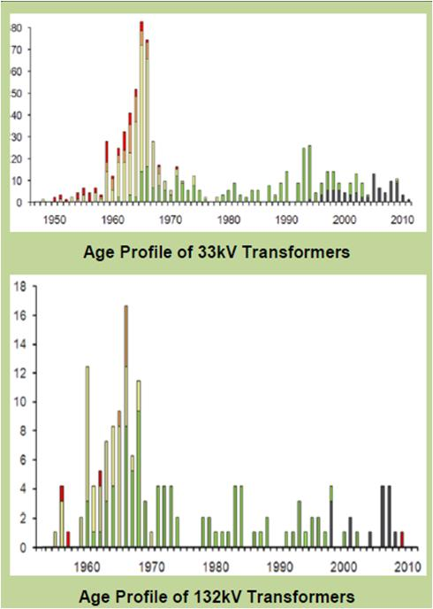
Ageing asset base
Age profile of assets
Notes:
Peak due to rural electrification, economic and population growth in the 1960s.
DNOs manage an increasingly aged asset base
Many assets now approaching traditional end of life
Even if it were possible to fund the replacement of these assets according to their age profile, the scale of the replacement programme would be cost, disruption and resources prohibitive
New assets are ageing more quickly and are less reliable that older assets

Slide 12
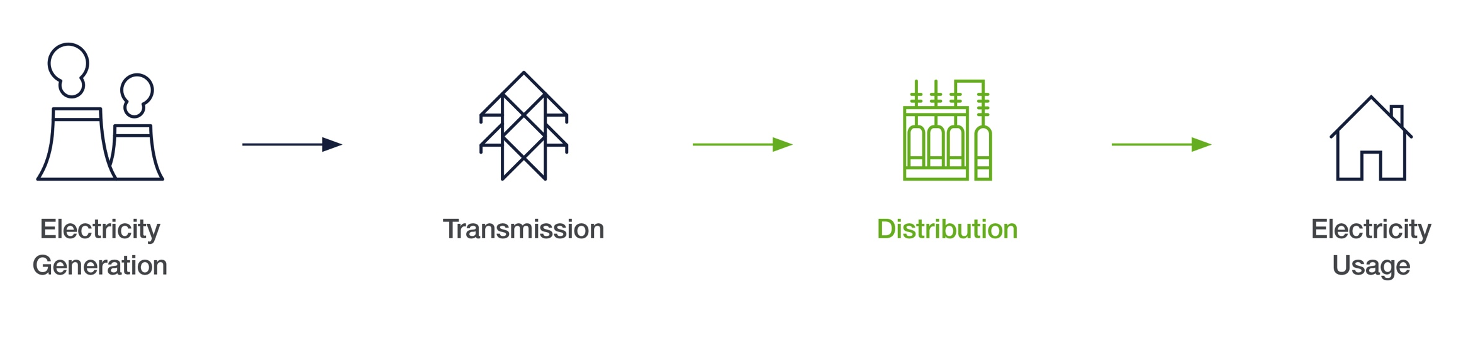
What used to be relatively simple …

Slide 13
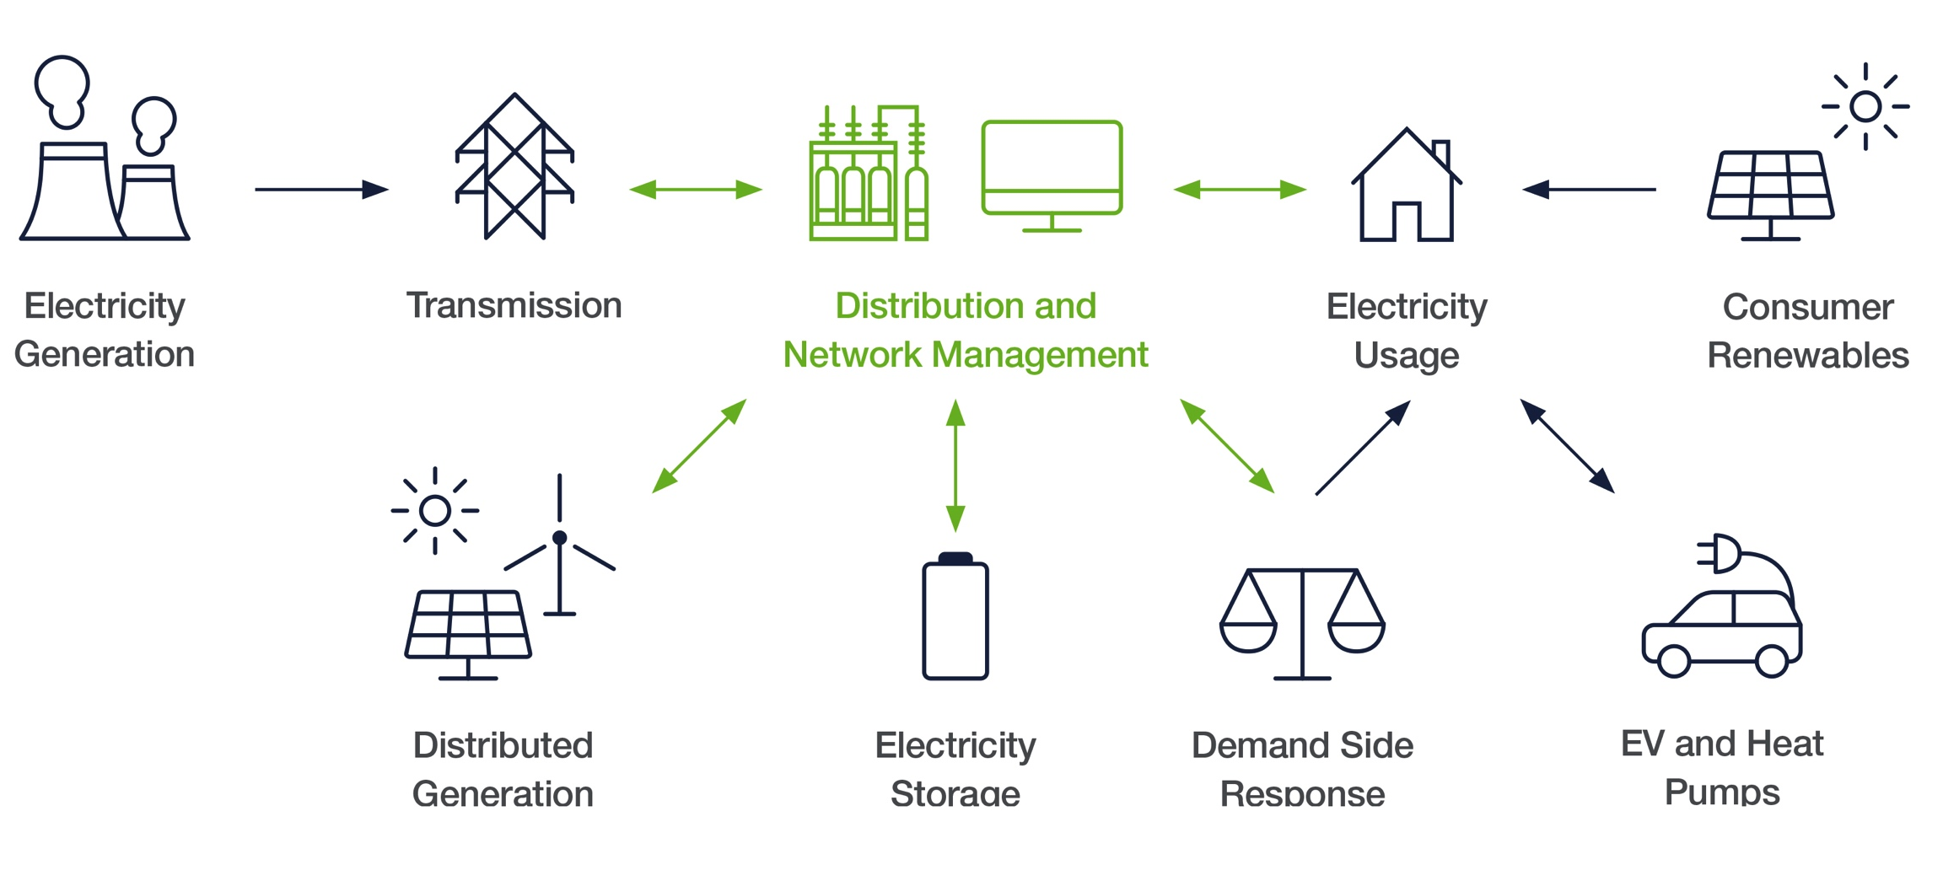
…is becoming far more complex and multi-directional

Slide 14
Electricity and structure of the grid
Victoria Turnham

Slide 15
A
B
C
Transform
275kV to 132kV
or
400kV to 132kV
132kV
275kV or 400kV
Transformation
Transformer
Transform
132kV to 33kV
Heavy Industry
33kV
33kV
Transform
33kV to
11kV or 6.6kV
Transformer
33kV to
11kV or 6.6kV
Transform
11kV or 6.6kV
to 400V or 230V
Shops & Houses
400 / 230 volts
Light Industry
11kV
Notes:
This diagram shows a simplified model of the electricity network.
Large scale generators produce electricity from a range of sources historically the major sources have been: Coal, Gas, Nuclear
The Generated power is transformed to a standardized voltage for transmission through the network. Within the UK this is normally either 400kV or 275KV. The transmission system operators transport the power through their networks until it reaches a step down substation which is generally a shared site between the Transmission network operator and the distribution network operator. The Distribution network operator takes control of the power at 132kV. At 132kV the network operator either supplies really heavy industries e.g. an oil refinery or they transport the power to a smaller substation site where the power is converted to 33KV. This would be the voltage most large customers would be supplied at e.g. Manchester airport, Universities. Typically users of more than 5MW of power required
From 33kV the power can then be transformed down to High Voltage. This is the voltage that most commercial customers are supplied at and typically is a voltage used for connections between 1MW-5MW. E.g. Heinz factory, Blackpool zoo, large hotels.
For the majority of customers of the network; the power is eventually transformed down to low voltage. This is the voltage which is supplied from a standard 13A socket. Customers of ENWL requesting a supply up to about 1MW may be offered a connection to the LV network.

Slide 16
Roles and responsibilities
Generation/
wholesale
UK System Operator
(NETSO)
Transmission Operators
(TO)
Distribution Network Operators
(DNO)
Independent Distribution Network Operators (IDNO)
Retail
Generate and sell electricity to the ‘Market’
Responsible for balancing the UK Electricity network power flows
Own and operate the transmission network
Provide the wires which move large quantities of power around the country
Own and operate the public distribution network
Provide the wires which get the power to homes and businesses
Own and operate a small section of distribution network within another DNOs licence area
Responsible for buying electricity from the ‘market’ and then selling it to their customers
ie who you pay your electricity bill to
EON, DRAX, Scottish Power, RWE , Horizon Nuclear
National Grid
National Grid, SSEN, SPEN, NIEN
ENWL, SPEN, UKPN, SSEN, NPG, WPD
Energetics, GTC, ESP, Eclipse Power, Energy Assets Networks
British Gas, EON, EDF, SSE, Scottish Power, Co-op, GB Energy Supply, OVO
Notes:
Who are the major participants in the Electricity Supply Industry

Slide 17

Keeping the lights on – three problems
To keep the power system stable ...
1
Balance generation and demand across the UK in real time
2
Stop our power escaping
  3
  Maintain the voltage = pressure

Slide 18
Problem 1: Generation and demand balance
No storage so we must make power
at the instant customers want to use it across the UK
Balance = constant speed of
50 miles/hour = 50Hz
Accelerator = Generation
Gradient
=
Demand

Slide 19
Managing the speed – Frequency control
Why do we need constant speed ?
At - 4%
system
collapses
At + 4%
system
bursts
What is round
the next bend ?
How much
will
customers
need ?

Slide 20
How much will customers need ?
GW
55
50
Maximum Winter Day
45
40
Typical Winter Day
35
Typical Summer Day
30
25
Minimum Summer Day
20
15
00:00
02:00
04:00
06:00
08:00
10:00
12:00
14:00
16:00
18:00
20:00
22:00
24:00

Slide 21
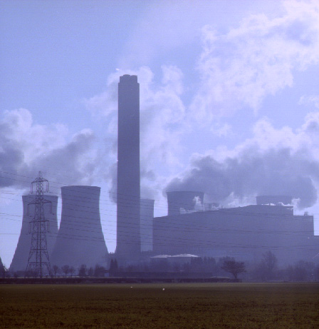
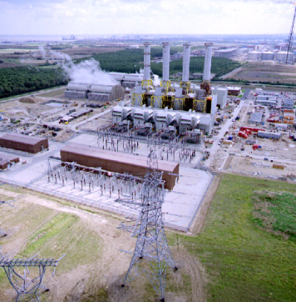
Which power stations and when ?
Slow start
Battery Storage
Pumped Storage
Gas Turbines
CCGT
Oil Fired
Small Coal
Large Coal
Nuclear
<1 second
10 seconds
2 minutes
6 hours
8 hours
Quick start
12 hours
24 hours
48 hours
Objective is to have most economic mix of stations available just in time

Slide 22
How do customers react to the weather?
Change in forecast weather
Response (MW)
Power stations
A fall of 1 degree Celsius
+ 400
(1%)
Increase of 10 knotts
+ 700
(2%)
Heavy rain
+ 800
(2%)
Clear sky to thick cloud
+ 1500 (4%)

Slide 23
What impact does TV have?
Wimbledon Men’s Singles Final 2013 (Andy Murray wins)
National Grid Demand (MW)
32,200
Broadcast ends
Match builds to a conclusion Murray wins
31,800
31,400
Match begins
End of second set
31,000
End of first set
30,600
30,200
29,800
300 MW
from steam plant generation
300 MW
from steam plant generation
600 MW from steam plant generation
200 MW
from steam plant generation
29,400
7 July 2013 (day of final)
300 MW from open cycle gas turbine
1400 MW
from pumped hydro turbines
Historical demand for a similar day

Slide 24
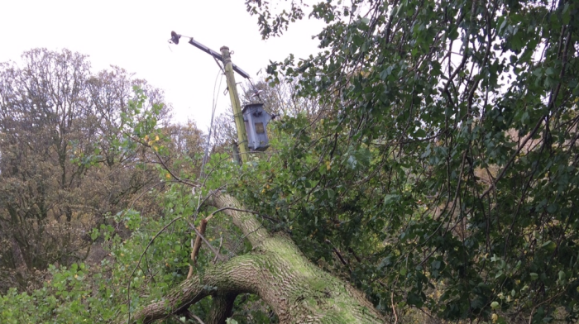
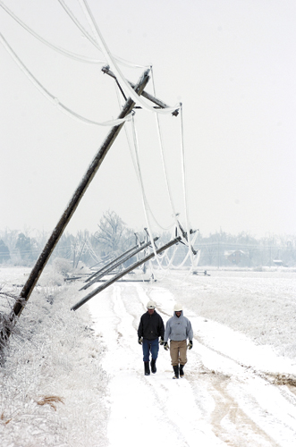
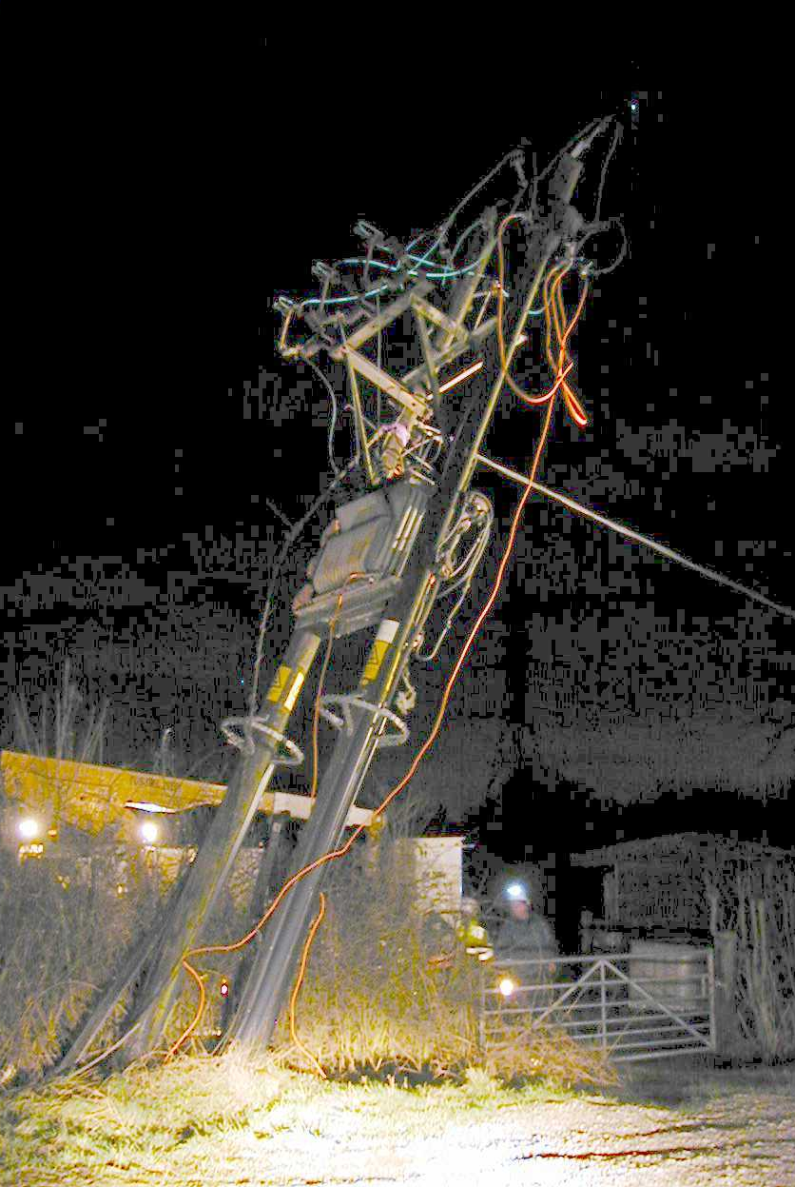
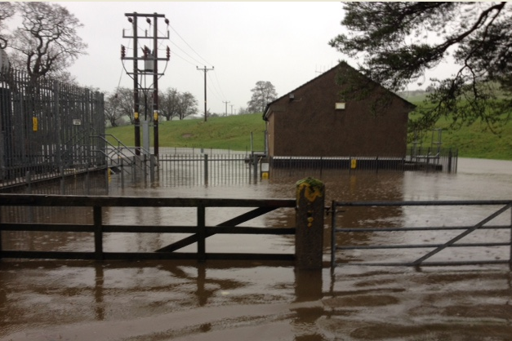
Problem 2: Stop your power escaping
Equipment affected by lots of external factors beyond our control

Slide 25
Why bother with the burst ?
When the fault occurs all power rushes into the burst
  The careful balance is broken
  Huge amounts of energy released
  The longer the fault lasts the more energy is released
  A 1-second fault @ 132kV releases 7GJ
So! Find it and stop it fast
Typically within 200ms
Or Else?

Slide 26
Problem 3: Voltage – keeping enough in the system
Reactive power is difficult to move around
12 – 15% shortfall leads to instant voltage collapse
Scotland
Need enough in
each region
Loss of local generation or circuits can lead to localised grid failure
France

Slide 27
Transformers
National Grid
132/33 kV Transformer
33/11 kv Transformer
11kv/230v Transformer
90,000 properties
20,000 properties
1 - 500 properties

Slide 28
CRMS
Notes:
https://telemw2.enwl.intra/opv2/public/index.php?controller=login

Slide 29
How we manage grid capacity
Simon Brooke

Slide 30


The challenges
A
B
C
  Changing customer needs
  LCT penetration driving demand
Expensive and carbon intensive reinforcement not affordable
High customer bills
Fuel poverty
Low penetration of renewable generation at community level
Random locations exclude network benefits
Benefits not aligned with costs
Notes:
Customer electricity needs are set to change, for instance the recently announced National Air Quality Plan’s stating the government’s aim for all new sales of conventional petrol and diesel cars and vans to end by 2040.
To support this rapid uptake in LCTs using our traditional approach would require expensive and carbon intensive network reinforcement, this cost would in turn be passed on to customers, having negative impact on their energy bills.

Slide 31

Our strategy
  Review historical demand and generation trends
Make a forecast of future energy demands utilising a range of inputs
Assess the impact of future energy demands on different areas of the network
Develop solutions to resolve predicted network constraints
Assess proposed solutions to determine the optimum balance of cost, time, and probability of requirement

Slide 32
What we see on our network
Transmission grid
Measured Demand
Measured demand
Latent Demand (Generation)
True demand
Latent demand
Demand
(or True Demand or Group Demand)
Loads
DG units

Slide 33
Understanding true demand
True demand
Measured demand
Monitored DG exports
Non-monitored DG
Effects of DG on reducing customer demand at sites with export metering
Monitored component of true demand

Slide 34

Forecasting approach
Underlying demand based on 35 customer archetypes matched to substations
Demand Technologies | Generation Technologies | Energy Storage Technologies
Electric vehicles | Solar PV | Domestic storage (with solar PV)
Heat pumps (domestic and I&C) | Wind | I&C storage behind the meter
Air conditioning (domestic and I&C) | Micro and larger CHP | Frequency response
 | Flexible generation
 | Other generation
Notes:
Forecast underlying demand based on 35 customer archetypes, matched to substation by postcode sector and LSOA, based on models developed in previous work by Element Energy for the Energy Saving Trust, the Department of Energy and Climate Change, the Committee on Climate Change and the Energy Technologies Institute.
In addition to the projection of domestic and I&C demand, the model addresses the uptake of various technologies:
Pre-defined uptake scenarios in the model are based on published forecasts and Element Energy’s models of the uptake of new technologies under current policy assumptions (and variations where applicable).
Additional scenarios based on the DECC/Transform and NG FES forecasts for technology uptake have also been included.

Slide 35
Example of future scenario predictions
Aggregate BSP winter peaks,
before additional connections
Other
analysis
Minimum demand for assessment of available capacity for generation
Maximum reactive power exports to transmission network

Slide 36
Capacity provision
Identify need
Detailed needs studies and optioneering
Approval

Slide 37
Flexible services
Response services provided to utility companies which offers customers incentives to reduce their electricity usage or increase their generation during times of peak demand
At peak times, demand for energy can outstrip supply placing stress on the electricity network
Energy suppliers need to generate more electricity to meet peak demand which is expensive and increases customers’ bills
By changing their electricity usage, consumers can benefit financially and help balance the grid
Consumers can provide a demand response (DR) by providing additional generation or storage, or by reducing usage
Electricity North West has used DR for a few years as an alternative to reinforcement. These DR techniques are now known as flexible services
Notes:
A potential solution to convention reinforcement is to utilise flexible services.
ENWL have recently conducted an exercise to gauge the market within out licence area for flexible service provision where further reinforcement requirements have been identified.

Slide 38

Target areas, 2018 – 2020
Substation | Area served
Alston, near Carlisle | Cumbria
Coniston | Cumbria
Easton | Cumbria
Nelson | East Lancashire
Blackfriars Road | Salford and Central Manchester
Cheetham Hill | North Manchester
Stuart Street | Central and East Manchester
Easton
Alston
Coniston
Lancaster
Preston
Nelson
Cheetham Hill
Blackfriars
Stuart Street
Manchester
Macclesfield

Slide 39
Indicative requirements – winter 2018/19
Network location | Voltage of connection | Total flexible service requirement 2018/19 (MW) | Availability window |  |  |  |  | Utilisation rate
 |  |  | Months | Earliest start date | Latest end date | Times | Days
Alston | LV or HV | 0.5 | Nov - Mar | Nov-18 | Mar-19 | 06:30 to 21:30 | All week | Up to 40 hrs pa
Coniston | LV or HV | 1.0 | Nov - Mar | Nov-18 | Mar-19 | All day | All week | Up to 40 hrs pa
Easton | LV or HV | 2.0 | Nov - Mar | Nov-18 | Mar-19 | All day | All week | Up to 40 hrs pa
Nelson | HV or 33kV | 20.0 | Oct - Mar | Oct-18 | Mar-19 | 06:30 to 21:30 | All week | Up to 40 hrs pa
Blackfriars | LV or HV | 0.5 | Jan - Feb | Jan-19 | Feb-19 | 16:30 to 21:30 | Weekdays | Up to 40 hrs pa
Cheetham Hill | LV or HV | 2.5 | Nov - Mar | Nov-18 | Mar-19 | 11:30 to 21:30 | All week | Up to 40 hrs pa
Stuart Street | HV or 33kV | 9.5 | Nov - Feb | Nov-18 | Mar-19 | 06:30 to 21:30 | Weekdays | Up to 40 hrs pa

Slide 40
Future requirements
Network location | Approximate requirement (MW)
 | 18/19 | 19/20 | 20/21 | 21/22 | 22/23
Alston | 0.5 | 0.5 | 0.5 | 0.5 | 1.0
Coniston | 1.0 | 1.0 | 1.0 | 1.0 | 1.0
Easton | 2.0 | 2.0 | 2.0 | 2.0 | 2.0
Nelson | 20.0 | 20.5 | 21.0 | 22.0 | 22.5
Blackfriars | 0.5 | 1.0 | 1.0 | 1.5 | 1.5
Cheetham Hill | 2.5 | 2.5 | 2.5 | 2.5 | 3.0
Stuart Street | 9.5 | 19.5 | 19.5 | 20.5 | 21.5
Notes:
Community energy groups could offer solutions to these constraints where they are able to aggregate customer supply flexibility within their community.

Slide 41
Summary
Credible demand and generation scenarios, reflecting uncertainty.
Tailored to our region, assets and data
Support
well-justified strategic planning of network capacity
Enabling good decisions about solutions to capacity problems,
and informed dialogue
with National Grid and other stakeholders

Slide 42
Coffee Break

Slide 43
New connection applications – How can we help?
Dave Barlow

Slide 44
Introduction
Dave Barlow – Design Engineer
18 years for the Company, all in Connections.
16 years as a Design Engineer
HV Demand and HV / LV Generation in Lancashire.

Slide 45
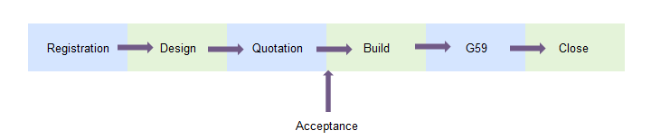
Agenda
Connection Process
Connection application
Touch upon Industry Governance
Please ask questions throughout

Slide 46
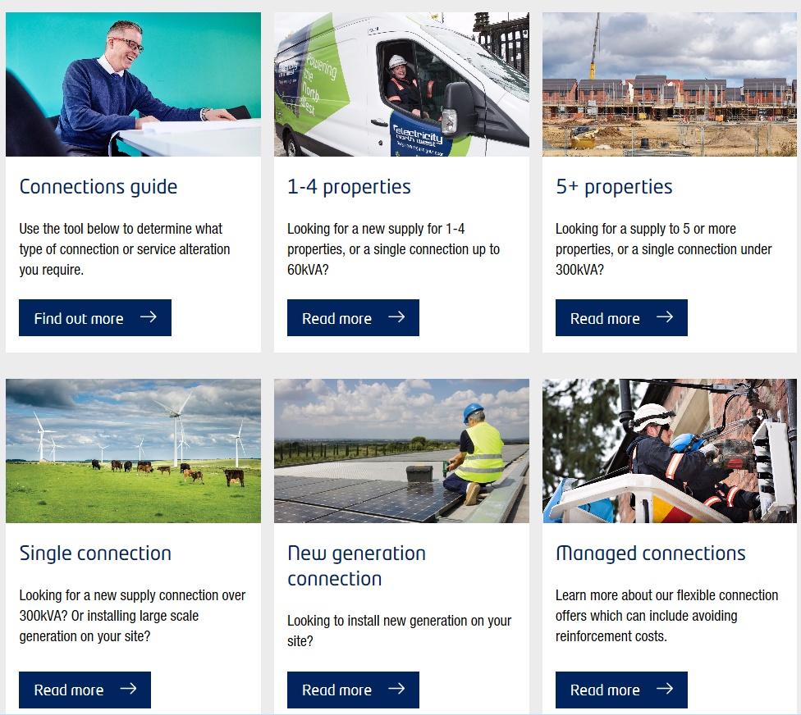
Getting Started - ENW Website
www.enwl.co.uk/get-connected/new-connection/

Slide 47
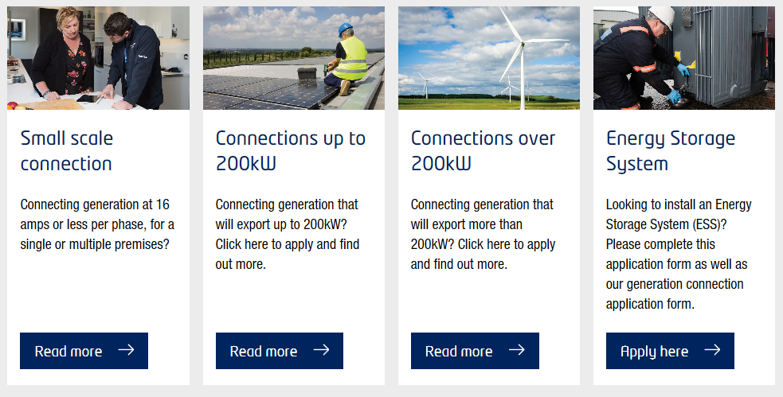
Getting Started - Generation
Link to ENW website – www.enwl.co.uk/get-connected/new-connection/new-generation-connected
Notes:
Small scale is the G83 notifications
Up to 200kW is G59 – was introduced so we had a simpler form for LV connections – import export – more through existing supply than a new connection.
Connections form over 200kW, similar to ENA form – asks for things like power station active import export / reactive power leading, lagging / fault current contribution.

Slide 48
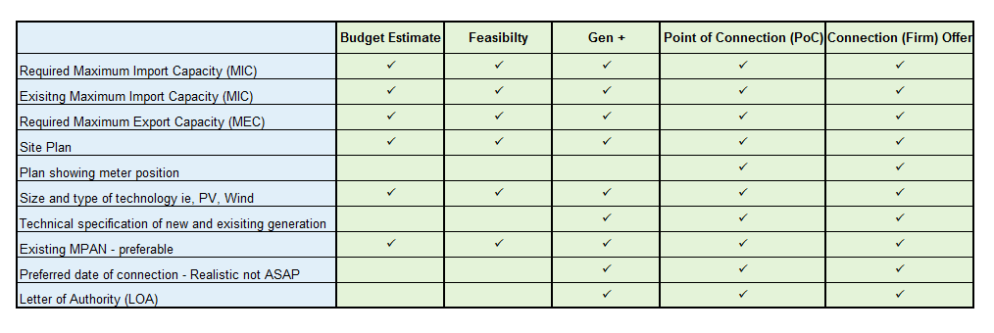
Minimum Information for Applications
The more information we receive, will enable us to process your application more efficiently.

Slide 49
Additional Information
These additional points of information are very useful when helping us provide a good level of service to yourselves.
Do you have planning permission?
Meter position for new supply.
What is your budget? Is there a figure that makes the scheme unviable?
Do you just require the maximum export based upon the existing supply arrangement? i.e. A zero cost quotation
Plan showing land boundaries, details of third party ownership.
Substation position.
Do you intend to install Export Limitation? Familiarise with EREC G100, Maximum power Station Capacity.
G59 – Single Line Diagram, inverters
Notes:
These additional points of information are very useful when helping us provide a good level of service to yourselves.
Help us to help you.
Together we can save each other time and money.
Talk through G100 power station capacity.

Slide 50
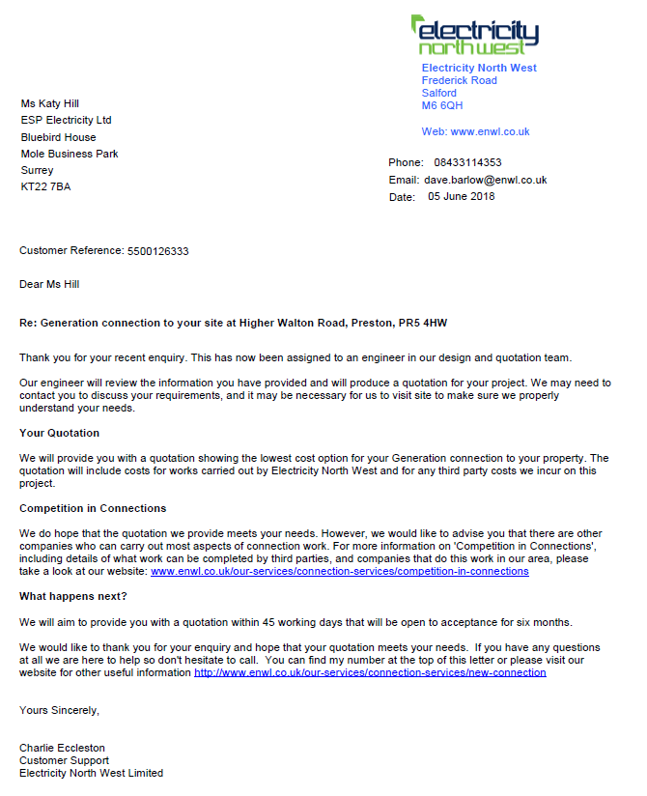
Application Acknowledgement
Once your application has been processed you will
receive an acknowledgment via email
Engineers name, contact number and email
Address
Customer reference 55.......
GSoP Standard

Slide 51
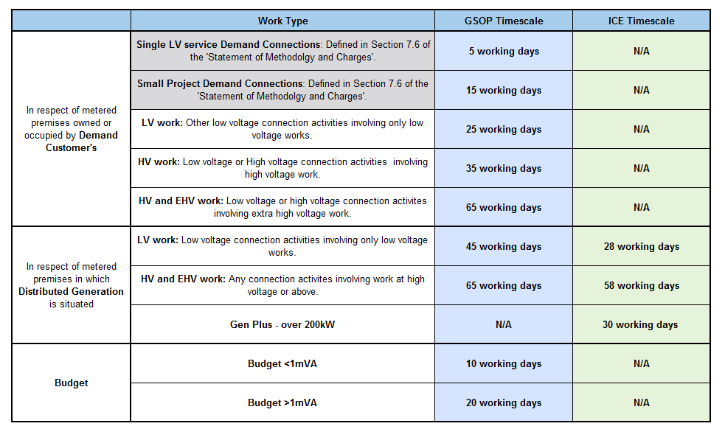
GSoP – Guaranteed Standards of Performance
Summary of the Electricity (Connection Standards of Performance) Regulations 2015

Slide 52
Network Analysis
The designated engineer will do a network analysis to determine a new point of connection on the network or determine whether the existing supply arrangement is adequate.
Things we look at:
Which network we are connecting to 33kV / 11kV / 6.6kV.
What other generators are on the network, connected and proposed.
Minimum system demand – dependant on type of prime mover.
Electrical issues associated with the connection:
  Voltage.
  Current carrying capacity (thermal).
  Fault Level.
  Harmonics and flicker – effects on other customers.
Whether network reinforcement is required.

Slide 53
Design & Quotation
Cable overhead line routes
Land rights
Locations for the new equipment
Timescales – would a underground route be a better option?
Environmental Issues - National Parks, British Waterways, Major Pipelines
Condition of our existing assets – wood poles, transformers
Classification of the highways
DECC Approval
Wind Turbines – Topple Distance
ENW Policies – Codes of Practice, EPD, ES, G59, ENA Documents
Our license obligation is to provide the cheapest cost option. Most practical
Types of Quotations – Standard / Dual / POC
Valid 180 days

Slide 54
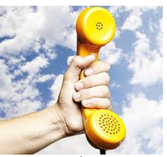
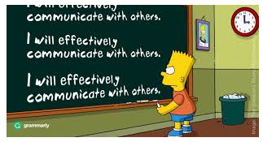
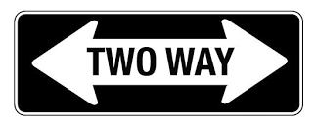
Any questions?
Any queries, issues, questions – please pick the phone
Send an email
Every scheme is unique.
How can we work together better?

Slide 55





Energy Solutions
OUR SERVICES
HOW WE SUPPORT
Domestic Connections
1-4 plots
Service alterations
Extensions
Guaranteed standards of performance
Small business connections
5 or more plots
Broad Measure of Customer
Satisfaction
Energy Solutions
Small to large generation
Community schemes
Business installations
Incentive on Connections
Engagement commitments
Industrial connections
Large scale developments
Diversions
Large power generation
Workshops, surgery sessions
Pre-application guidance
Post acceptance guidance
Notes:
Another role we play in community and local energy is responding to connections requests and this is done by our energy solutions business.
My colleague Tracey Taylor is here is you have any technical questions or enquiries.
DG workshop tomorrow at Hartington Road in Preston – check numbers with Rebecca.

Slide 56
Work Required in Designing a Connection
Typical checks ENWL must carry out:
Confirm that the application makes sense
Where is the nearest connection point
Any electrical issues associated with the connection to proposed connection point:
  Voltage,
  Current carrying capacity (thermal)
  Safety limits of equipment (fault level and protection)
  Impact upon other customers supplies (harmonics and Flicker).
  Checks relating to customer equipment and construction impacts upon ENWLs equipment (e.g. are wind turbines too close to overhead lines, is there a requirement to divert equipment?)
  Any issues relating to the Transmission Network
  Environmental factors (National Parks, Sites of special scientific interest, topology of land, ground conditions)
  Condition of existing equipment (are wood poles suitable for a new heavier conductor to be used)
I
Identify work to enable the connection:
Cable/overhead line routes
Land rights
Locations for new equipment
Timescales for connections
Telecomms infrastructure

Slide 57
Typical Challenges
Application:
Missing or incorrect information provided within application forms
Requests for unnecessary security of supply
Technical:
Local Electrical network does not have sufficient capacity to enable the connection.
Connection type or Demand/generation variant is not ideal – E.g. solar panels output during the day when the network is in a state of reduced demand, Electric vehicles generally are plugged in during the evening peak demand period
Environmental/External factors:
Planning restrictions upon building new equipment e.g. no new overhead lines within national parks.
3rd party Landowners unwilling to provide legal consents to cross their land
Increased cost and complexity associated with working near transportation routes and pipelines e.g. crossing railway lines, motorways, fuel and gas pipelines.
Topology of land causing issues e.g. excavating in hard rock areas, building overhead lines over hills, crossing rivers.
Weather and flooding e.g. Overhead lines built in windy areas must be of a heavier build construction, substations should not be located in flood risk areas or should be suitable protected.

Slide 58
What can be done?
Application:
Ensure applications match actual requirements
Ensuring requests are for the required level of security. I.e. Increased levels of supply security come with a much higher price and complexity.
Allow sufficient time for application, design, delivery and energisation.
Check heat maps to see if there is likely to be reinforcement
Look to co-locate different generation and demand technologies to provide a controllable electrical demand. E.g. co-locating solar panels with storage at home.
Flexible Connections:
If you are prepared to accept a flexible connection then there is a much better chance of a connection with reduced reinforcement/connection costs. Options for flexible connections:
Timed Capacity Connections - a time limited connection to manage constraint
Export limitation – Matching generation with demand to limit the export to the network
Active Network Management– DNO dynamically control the network to balance demand and generation
Intertrip Schemes – Automatic trip sent to connection if a safety limit is reached following an abnormal operation condition.
Environmental/External factors:
  Be aware of local planning issues and constraints
  Speak to surrounding landowners and gain their support
  Avoid flood risk areas
Notes:
Typical minimum timescales (Application- Energisation):
LV – 6 month
HV – 18 months
33kV – 24 months
132kV – 30 months
Timed Capacity Connections - e.g. cannot generate between 10:30am – 2pm

Slide 59
Generation connection application case study
Neil McClymont

Slide 60
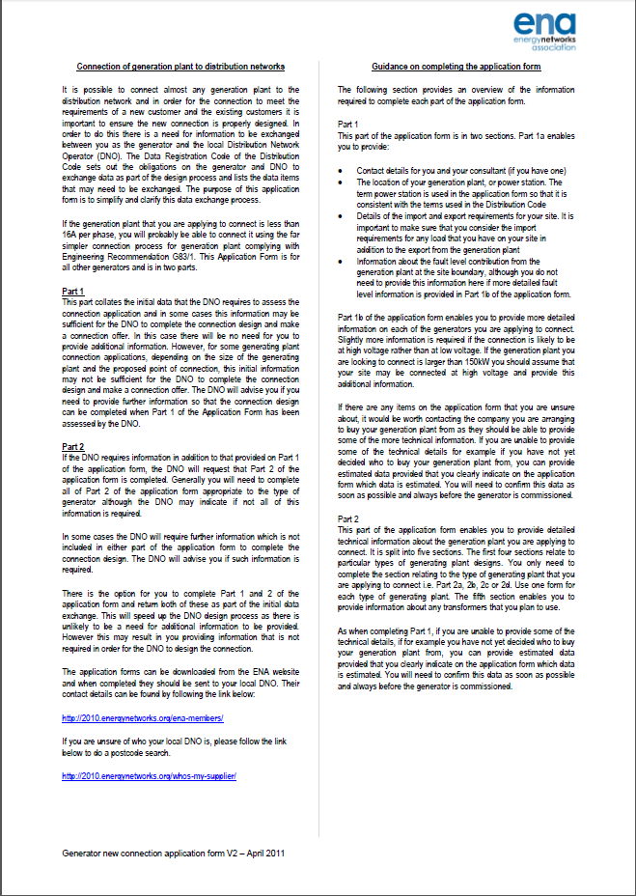
Scenario
Mr Jones owns a field in Kendal. He has decided that he would like to install a wind turbine on his farm.
Following speaking with the consultant he is advised there is sufficient Land to install a 1MW wind turbine but he is also recommended to install 500kW of solar panels within his field.
The consultant prepares and submits an application to ENWL for a connection of 1.5MW
Following checking that the application form is correct (competent) the application is given a reference number as well as its start date being logged.
Note: Only once an application is deemed competent is it entered into any queues for quotation and interactivity.

Slide 61
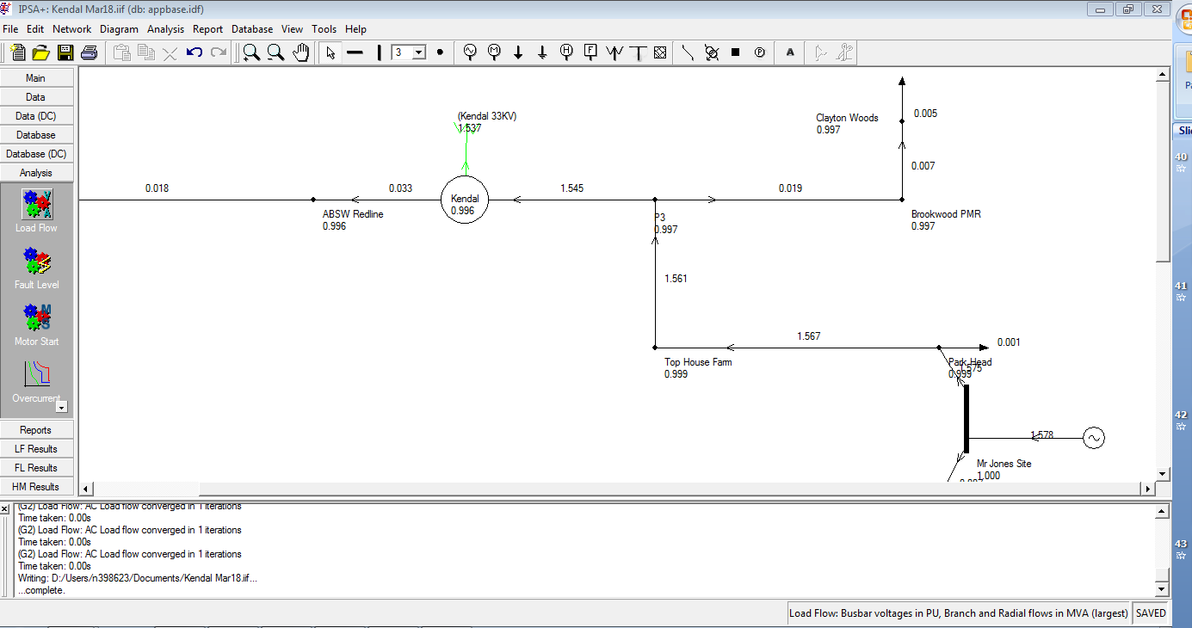
Application submission
The application is passed to a design team who carry out a high level check to see how feasible the connection is taking into consideration Mr Jones’ expected timescales and likely budget.
The design team on reviewing the application decide that there is a possible solution which may be technically feasible so they proceed with more detailed studies.
After a week of being in the design queue a landowner of an adjacent field to Mr Jones’ decides to submit an application for a connection of a 2MW Battery storage system.
Upon completion of the study of Mr Jones’
connection there is found to be sufficient
capacity available on the 11kV voltage
network for a 2MW connection however
there is an issue with a 33kV cable which
feeds the 33/11KV transformer.

Slide 62
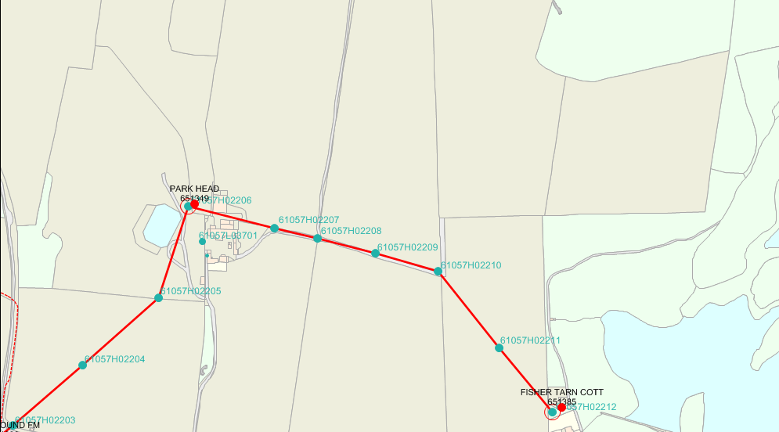
Quotation
The proposed connection is passed to an engineer to provide a quotation to Mr Jones.
Due to the limitations of the 33kV cable; a reinforcement scheme is required. The design team assess the potential network gain and determine that the costs will be apportioned.
Mr Jones connection will be issued subject to the reinforcement completion.
Proposed OHL route
Site
POC

Slide 63
Connection offer
As there is only sufficient capacity for one connection; the offers are sent out and made interactive. As Mr Jones was first in the design queue he is first in the interactivity queue.
Mr Jones decides to accept his quotation, resulting in the other applicant being unsuccessful.
Following Mr Jones accepting his interactive offer he pays the first stage payment to secure the capacity and fund initial delivery elements of the scheme.
The delivery team will begin work obtaining legal consents, carrying out tele-comms surveys, ordering switchgear, and booking outage windows.

Slide 64
Legal consents
During the process of acquiring legal consents it becomes apparent that it is not possible to gain the required consents for the proposed Overhead line route.
Mr Jones is made aware of this and a variation to the offer is produced to cover additional costs associated with a longer route.
Site
New Proposed OHL route
New POC
Problem
Area

Slide 65
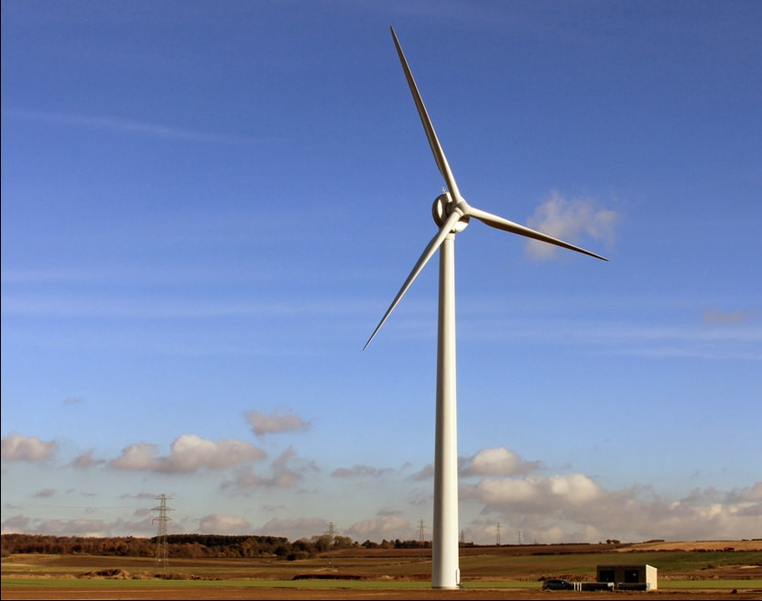
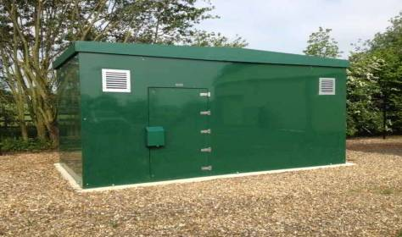
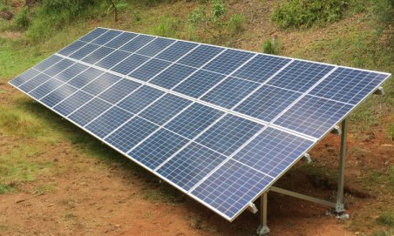
Energisation
Following completion of the required surveys, obtaining legal consents the project proceeds through to the build stage of delivery and all remaining payment are made.
ENWL complete the required reinforcement to the 33kV cable.
The connection is energised and a connection agreement between Mr Jones and ENWL is signed.

Slide 66
Work Required in Designing a Connection
Typical checks ENWL must carry out:
Confirm that the application makes sense
Where is the nearest connection point
Any electrical issues associated with the connection to proposed connection point:
  Voltage,
  Current carrying capacity (thermal)
  Safety limits of equipment (fault level and protection)
  Impact upon other customers supplies (harmonics and Flicker).
  Checks relating to customer equipment and construction impacts upon ENWLs equipment (e.g. are wind turbines too close to overhead lines, is there a requirement to divert equipment?)
  Any issues relating to the Transmission Network
  Environmental factors (National Parks, Sites of special scientific interest, topology of land, ground conditions)
  Condition of existing equipment (are wood poles suitable for a new heavier conductor to be used)
Identify work to enable the connection:
Cable/overhead line routes
Land rights
Locations for new equipment
Timescales for connections
Telecomms infrastructure

Slide 67
Typical Challenges
Application:
Missing or incorrect information provided within application forms
Requests for unnecessary security of supply
Technical:
Local Electrical network does not have sufficient capacity to enable the connection.
Connection type or Demand/generation variant is not ideal – E.g. solar panels output during the day when the network is in a state of reduced demand, Electric vehicles generally are plugged in during the evening peak demand period
Environmental/External factors:
Planning restrictions upon building new equipment e.g. no new overhead lines within national parks.
3rd party Landowners unwilling to provide legal consents to cross their land
Increased cost and complexity associated with working near transportation routes and pipelines e.g. crossing railway lines, motorways, fuel and gas pipelines.
Topology of land causing issues e.g. excavating in hard rock areas, building overhead lines over hills, crossing rivers.
Weather and flooding e.g. Overhead lines built in windy areas must be of a heavier build construction, substations should not be located in flood risk areas or should be suitable protected.

Slide 68
Checklist
Application:
Ensure applications match actual requirements
Ensuring requests are for the required level of security. i.e. Increased levels of supply security come with a much higher price and complexity.
Allow sufficient time for application, design, delivery and energisation.
Check heat maps to see if there is likely to be reinforcement
Look to co-locate different generation and demand technologies to provide a controllable electrical demand. E.g. co-locating solar panels with storage at home.
Flexible Connections:
If you are prepared to accept a flexible connection then there is a much better chance of a connection with reduced reinforcement/connection costs. Options for flexible connections:
Timed Capacity Connections - a time limited connection to manage constraint
Export limitation – Matching generation with demand to limit the export to the network
Active Network Management– DNO dynamically control the network to balance demand and generation
Intertrip Schemes – Automatic trip sent to connection if a safety limit is reached following an abnormal operation condition.
Environmental/External factors:
  Be aware of local planning issues and constraints
  Speak to surrounding landowners and gain their support
  Avoid flood risk areas
Notes:
Typical minimum timescales (Application- Energisation):
LV – 6 month
HV – 18 months
33kV – 24 months
132kV – 30 months
Timed Capacity Connections - e.g. cannot generate between 10:30am – 2pm

Slide 69
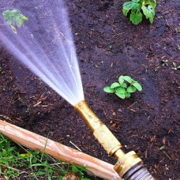

Voltage Rise
253V
V
216V
Notes:
This slide is designed to demonstrate voltage rise.
A conventional electricity network (without generation) is like a river which has a dam at the top and a lake at the bottom. Water flows from the dam down the valley and into the lake, losing height as it travels.
In an electricity network the voltage is highest at the substation (the dam), it then travels through the cables (river), and eventually into the lake (customers house). It starts at a higher voltage and looses voltage as it travels through the components. Additionally as the water flows down the hill there will be losses of water either through evaporation, and water soaking into the ground. These losses represent the power losses within the cable caused by resistance.
Now imagine that I turn a hose pipe on with an infinite supply of water at the lake. Eventually the lake fills up and there is nowhere else for the water to go other than back upstream and into the dam. The water must gain enough height to go over the dam wall to fill it. The electricity network is very similar, when you attach a generator to the network the generator acts as in infinite source of power. The generated Power will initially be used within the property, once the houses demand has been fulfilled power will start exporting to the network through the cables and back to the transformer. The transformer is outputting at a constant voltage of around 250V. To be able to export to the network the generator must overcome any network losses associated with the losses within the cables and then still remain at a higher voltage that the transformer.
If the cables are high resistance or there is lots of generation then the voltage at the generator will need to rise higher to export through the transformer. Eventually the voltage rises above the statutory limits and the network can enter an unsafe operating condition.
The negative effects of high voltage include: Higher energy usage and losses within the network (assuming constant current), damage to equipment, can cause overheating of equipment resulting in fires.

Slide 70
Fault Level
What is fault Level?
Fault level represents the amount of power which is the supplied to a fault within the network.
Why is it important?
It is important that all the equipment within the network can withstand the level of power flowing through it should a fault occur.
Eventually protection systems should operate to break a fault but this is not instantaneous.
Protection devices will have fault level rating of how much fault current they are able to withstand and break. If the rating is exceeded this may prevent a fault from being broken and/or cause major damage.
What contributes to fault level?
Electrical infeeds such as: Transformers, and Generators
Demand Devices: Motors, Capacitors
How to resolve Fault level issues?
Reduce the number of infeeds (may reduce supply security)
Increase the network impedance (increases losses)
Install equipment which is rated for higher current flows
Operate higher voltages, with low current
Utilise equipment which uses power electronics e.g. inverters, and variable speed drives

Slide 71
Heat Maps
Victoria Turnham

Slide 72
Heat Map Update
Delivering on our promises: Update on our progress regards our commitment: We have started development of improved heat maps Expect them to be available in Autumn 2018
Commitment | Action
We will improve visibility of remaining available capacity | We will publish improved information on available thermal capacity & fault level

Slide 73
Heat Map Update
Improved Heat Map Objectives: Map the ease of connection of large generators and demands Improve customer experience and utility Geographical indication of the ability to connect Improve access to network information Provide more up to date information Provide better information to support and inform customers’ own planning and design Provide detailed network information to improve customer understanding of network issues so that you can deduce the suitability of alternative connection approaches

Slide 74
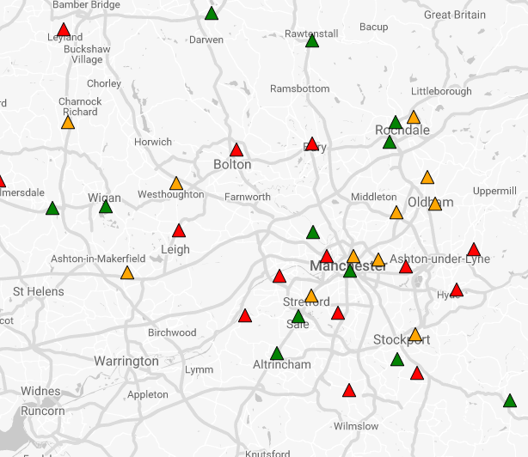
Heat Map Update
Example of Heat Map: Pinpoint locations Grid supply, 132/33kV & 33kV/HV substations Colour coded to guide customers to areas where connections can be made without significant reinforcement Summary of detailed information Indication of transmission network constraints
Development graphic

Slide 75
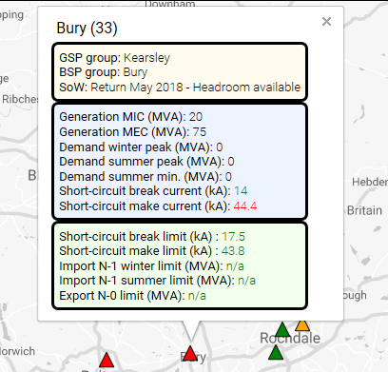
Heat Map Update
Data summary Network will be consistent with the Long Term Development Statement, supplemented with quantities of accepted generation connections Data will be regularly updated We will have the opportunity to extend the data in the future, e.g. Voltage issues or network reliability indices or flexibility requirements
Demand (max & min) vs thermal ratings
Connected generation vs reverse power capability
Fault levels vs fault level limitations
Development graphic

Slide 76
Heat Map Update
Data summary Permits consideration of thermal & fault level headroom Connections are still feasible where there is no thermal or fault level headroom, but they may; require network reinforcement or an alternative connection arrangement, such as temporary reduction in network access
Development graphic

Slide 77
Heat Map Update
Statement of Works Statement of Works summarise the results of National Grid’s assessments of the impact of Distributed generation on the transmission system. Generators ≥ 1MW Some statements of works have highlighted the need for reinforcement of the transmission network before more distributed generation is connected. There may be significant costs and delays to customers who initiate transmission network reinforcement works.
Heat map information will include information on
National Grid’s Statement of Works
Development graphic

Slide 78
Heat Map Update
We would appreciate your thoughts .......
Questions?
Development graphic

Slide 79
The future

Slide 80
Our approach
Offer new
services and
choice for the
future
Maximise
use of existing
assets
Delivering
value to
customers
Generate
value for
customers
now
Innovative
solutions
to real
problems
‘Fit and forget’
Proven
technology
deployable
today

Slide 81
From DNO to DSO
Old Distribution Network Operator model
New Distribution System Operator model
Low numbers of connections
Relatively easy to connect more demand
Limited customer engagement
Reactive management
Network sized to cope with peak winter demand
Very little renewable generation
Energy flows in multiple directions
Huge increase in number of renewable connections
Increasingly complex to manage supply and demand
Need to build relationships, and facilitate competition and innovation
Much higher use of electricity for electric vehicles and heat
  Electricity distributors will need to play a more sophisticated role

Slide 82
Our guiding principles
Neutral, but not silent
Network automation
Collaboration
No regrets
Everyone’s included
Affordable and efficient
We want to be a trusted source of information, helping to demystify the new, complex energy market, while remaining commercially neutral
We will provide sophisticated, automated network services that can meet the needs while keeping costs affordable
We will work with North West stakeholders and collaborate with them to develop local and regional solutions to deliver against devolved and national policy
We will work with stakeholders and customers to plan in a sensible, informed way which will facilitate the development of flexible markets in our region
We are committed to ensuring that the poorest in society are not disadvantaged by energy sector developments and have opportunities to secure benefits
We will continue to focus on value for money and on making efficient investment decisions

Slide 83
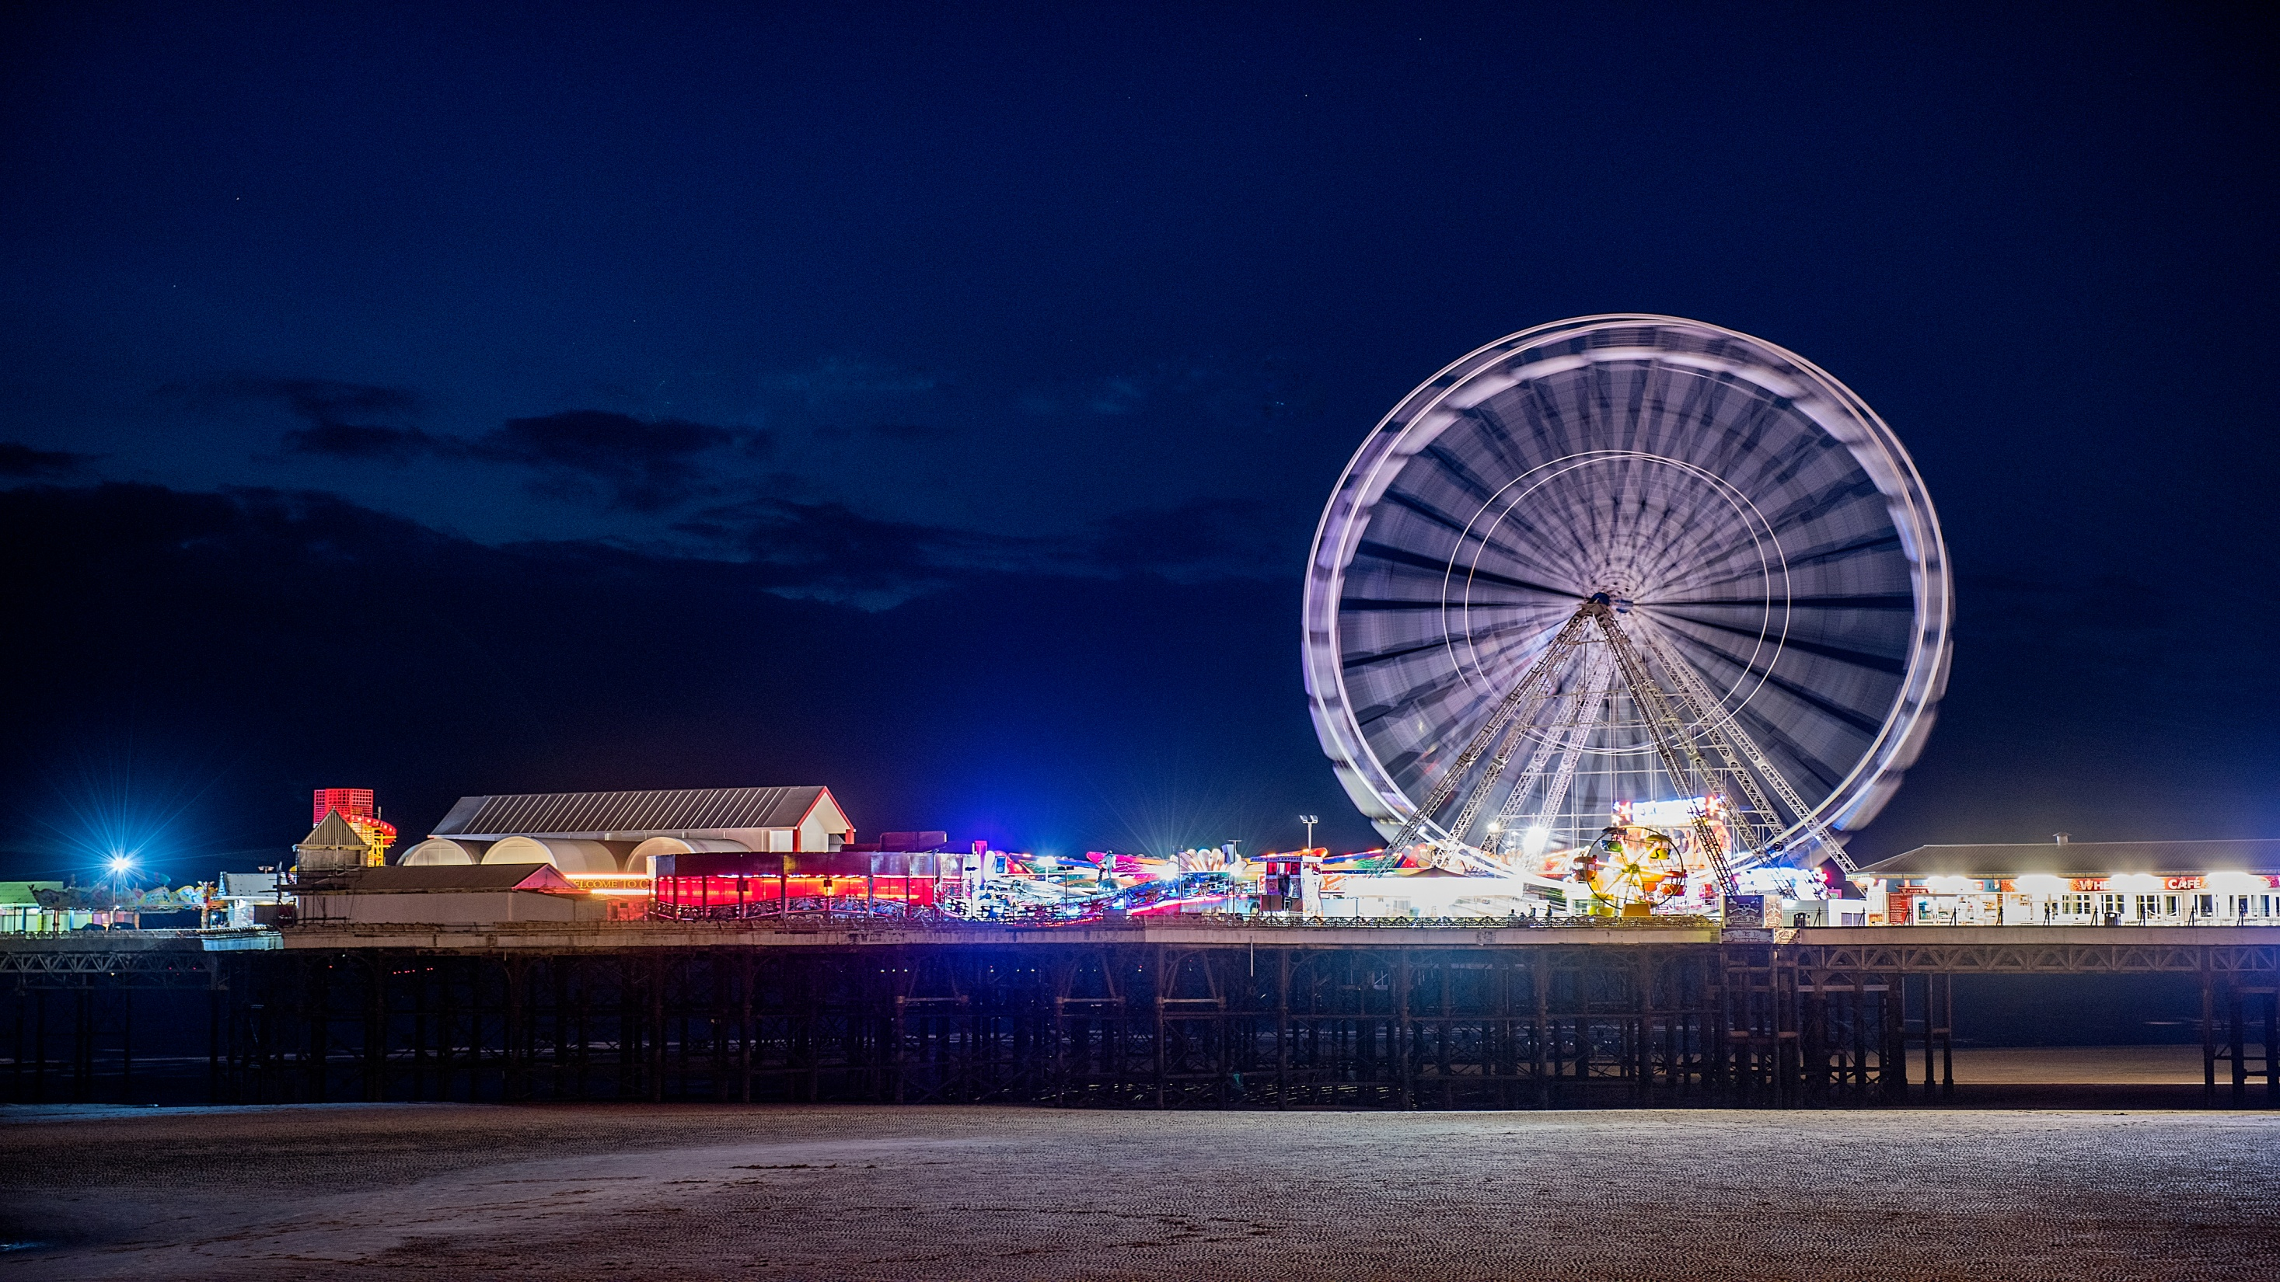
Opportunities for community and local energy
  Customer involvement is key:
  Community groups have great networks of interested stakeholders
  Greater participation in energy efficiency and low carbon energy is required: Community energy groups are already doing this
  DSOs will provide new market opportunities at a local level: Community energy is adaptable, flexible and potentially at the right scale

Slide 84
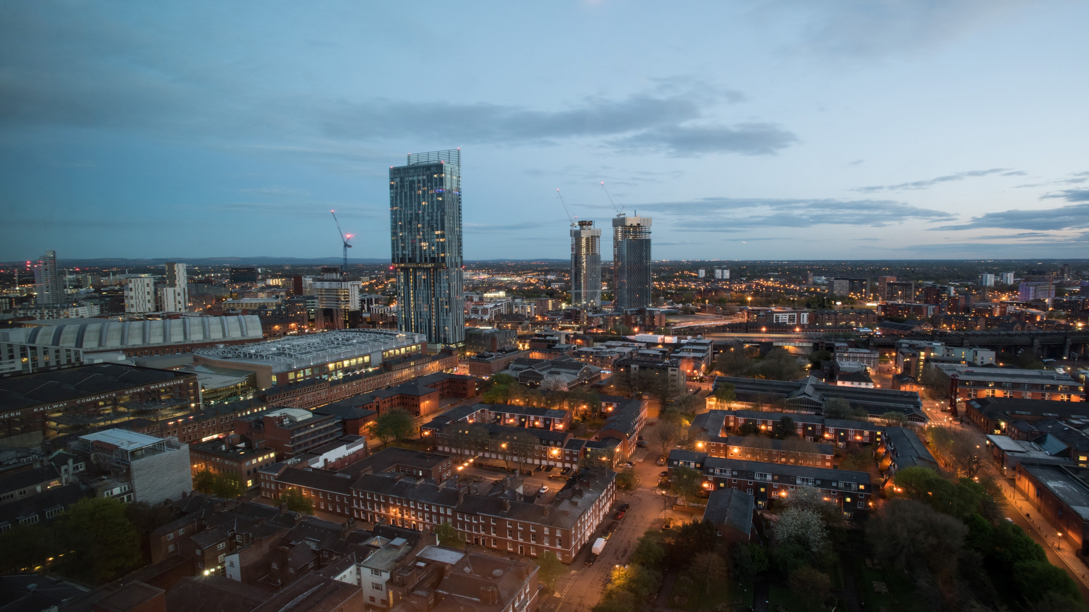
Our Community and Local Energy Strategy
We will be responsive to customers’ needs and deliver a stakeholder engagement plan that enables us to develop those relationships
  Forging links with community and local energy organisations
We will create new mechanisms for community and local energy groups to engage with us
We will search for locations on our network where community and local energy can be deployed
for the benefit of the network
Notes:
Can the bottom objective be re-worded to read:
“Searching for location to deploy community and local energy for network benefits”

Slide 85
Community energy project management ....without too many tears
Delivered by Quantum Strategy and Technology
Thursday 5th July, Preston
A ‘whole place approach’ to low carbon communities …an introduction
Delivered by Cumbria Action for Sustainability
Tuesday 18th September, Kendal
Energy Efficiency for community and local energy groups
Delivered by Carbon Co-op and URBED
Wednesday 17th October, Lancaster

