Slide 1

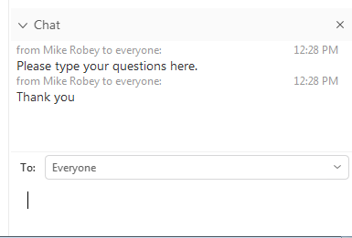
Your Questions
Webinar participants have been set to ‘listen-only’ mode to aide the smooth running of the webinar.
To raise your questions: please type questions in the ‘chat’ function of this webex meeting
We will review questions and pick them up at appropriate points during the webinar, where possible, or at the end of the presentation.
We have also prepared some questions for you
Graham Stein
National Grid ESO
Paul Munday
Scottish & Southern Electricity Networks
Mike Kay
National Grid ESO
WEBINAR WILL BEGIN AT 13:05
Friday 27 March 2020
https://www.energynetworks.org/electricity/engineering/accelerated-loss-of-mains-change-programme.html

Slide 2
Agenda
Item | Presenter
Welcome | Graham Stein
Introduction - The Accelerated Loss of Mains Change Programme - Progress to date | Graham Stein
Eligibility | Mike Kay
How to apply | Paul Munday
How to implement changes | Paul Munday
Resources to support your application and implementation of changes | Mike Kay
Timetable | Graham Stein
Programme website | https://www.energynetworks.org/electricity/engineering/accelerated-loss-of-mains-change-programme.html
Application portal | http://www.ena-eng.org/ALoMCP
Notes:
What is the problem that ALoMCP seeks to address?
Who is involved?
Who needs to take action?
What support is available? Funding levels for settings changes and relay replacement
Application and implementation process

Slide 3
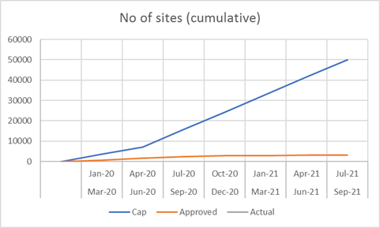
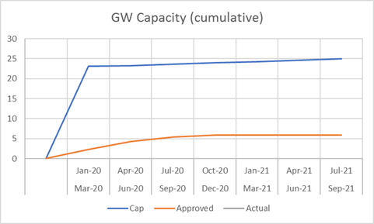
ALoMCP: Progress to date
Accepted Applications
Application Outcome
Window | No of applications | Generation applied | Generation accepted | Provider Payment (£m)
W1 | 1933 | 5.48GW | 4.3GW | 6.8
W2 | 1388 | 2.25GW | 2.2GW | 5.3
Total | 3321 | 7.73GW | 6.5GW | 12.1
Application Workflow

Slide 4
Coronavirus pandemic response
Due to the disruption caused by the Coronavirus pandemic, including the impact of measures taken by the government and businesses to protect the wellbeing of the public, the Programme has suspended delivery of the ALoMCP.
Under the current guidance the Programme is currently not classified as essential work, and DNO staff cannot plan site attendance for the purpose of witnessing and audit where these would have been required by the Programme. It is not possible at the moment to conduct this work remotely.
The Programme will issue guidance for in-flight projects as soon as possible. There is no plan to suspend payments to applicants who have already completed their work and these will be processed as is practicable under current working arrangements.
The ALoMC Programme will keep the situation under review and update this response as the situation changes.
Delivery dates of accepted applications will be relaxed and delivery timescales and window dates will be reviewed and revised in the light of Government and Regulatory direction and as information becomes available.
Generators, their agents and contractors are reminded to follow all government guidance with regards to travel and work restrictions.

Slide 5
Eligibility
Generation commissioned before February 2018
Generation of all types, eg synchronous, wind farms, solar PV
Where RoCoF or vector shift protection is used, either in separate G59 relays or within the generation equipment itself (eg including inverters)
Applies to all generation of any size above domestic scale – so anything of greater than about 3.6kW – right up to 50MW
The following are not eligible:
Standby generation
Generation >50MW or transmission connected
Generation that has already been converted from VS to RoCoF
It is the owner of the generation who has the responsibility, and is eligible for payment, but the Programme will deal with the owner’s agent
How to Apply
Programme website
https://www.energynetworks.org/electricity/engineering/accelerated-loss-of-mains-change-programme.html
Application portal
http://www.ena-eng.org/ALoMCP
Notes:
Refer to settings change v relay replacement
Where are we talking about inverters?

Slide 6
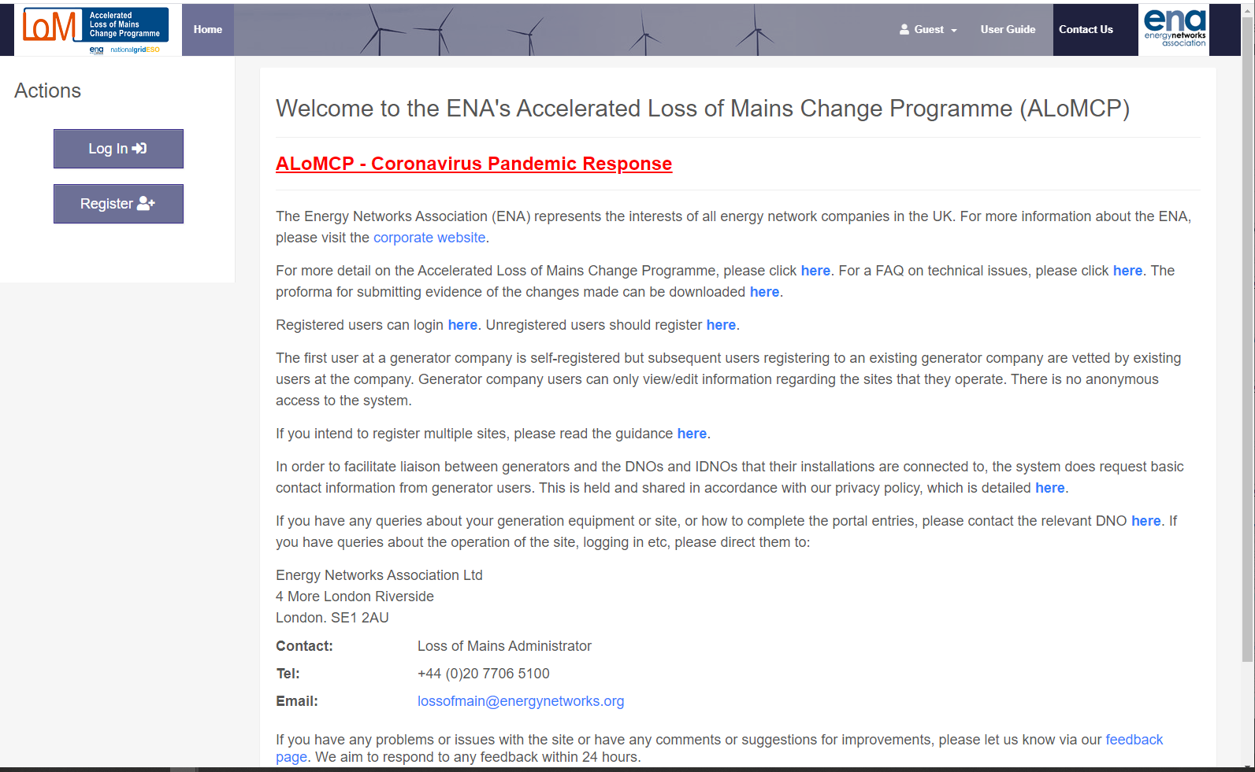
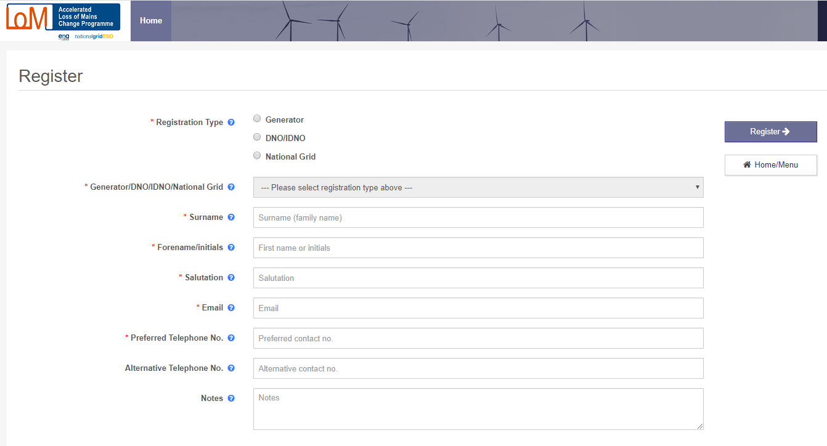
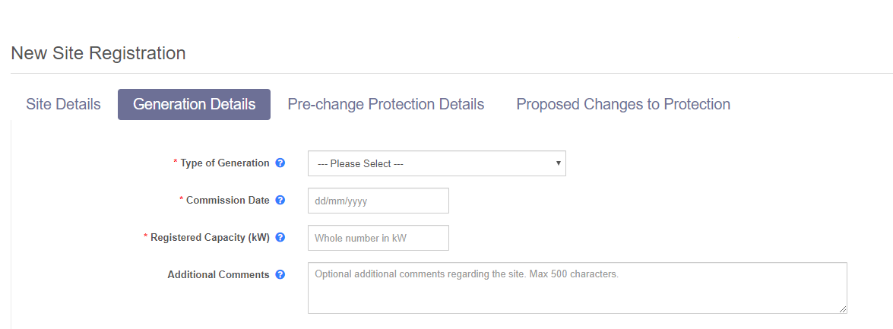
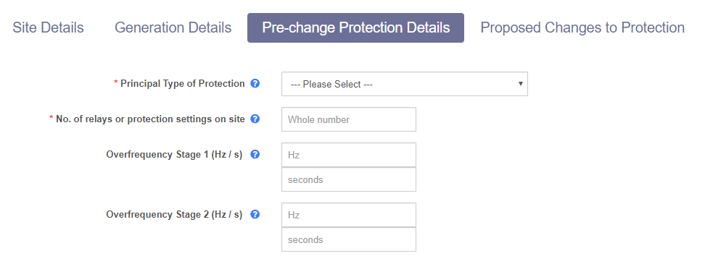
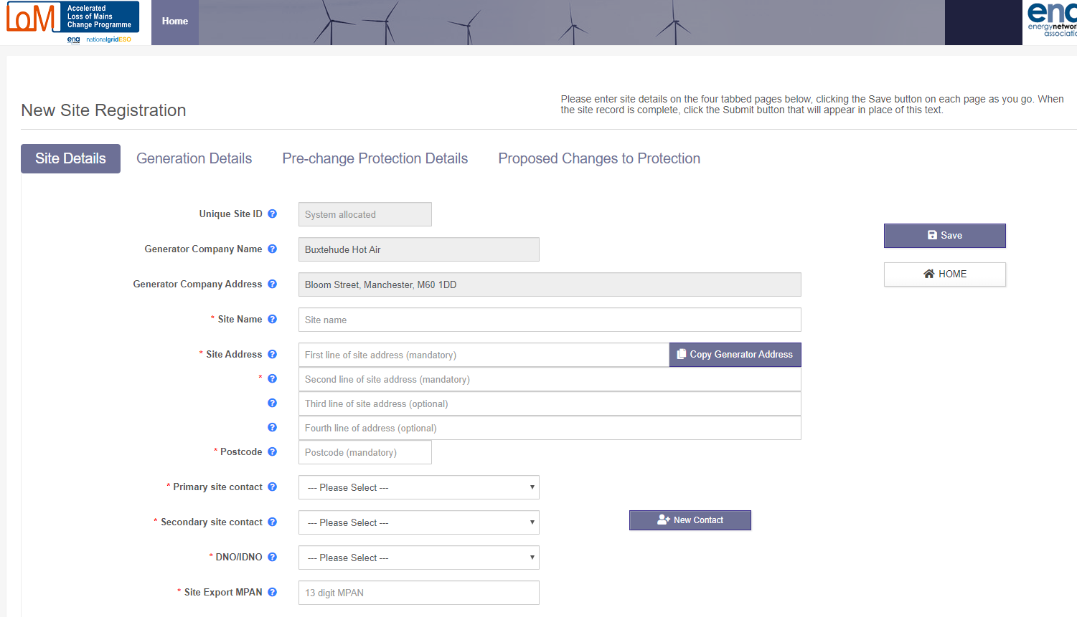
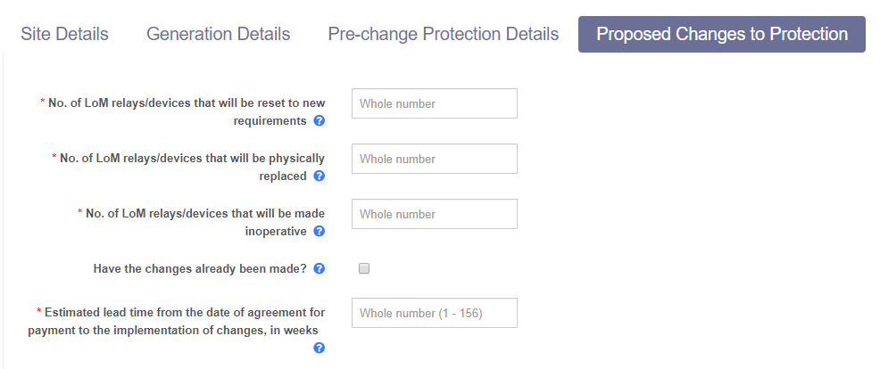
Home Screen
Registration
New Application – Generation Details
New Application – Pre-change Protection Details
New Application – Site Details
New Application – Proposed Changes in Protection
Scroll to the right

Slide 7
Changes to applications
‘Material Change’ where an application will need to be re-assessed by National Grid before funding can be agreed
Change of any number of relays from reset to replace
Increase in the number of devices to be reset/replaced
UNLESS the increase relates to settings changes only and the £4k cap has already been reached
Any other change that may reduce the benefit of changes at a site, such as;
Reduction of the registered capacity
Change in Generation Technology
Change in current LoM protection type
In these cases it will be necessary to delete the current application and for the generator to submit a new application.
‘Allowable change’ where the portal application can remain as it is and the record of changes can be ‘corrected’ at the end of the process by NGESO/DNO/Generator
Change of any number of relays from replace to reset
Reduction in number of devices being reset or replaced
Any change that does NOT reduce the benefit of changes made at a site
Programme website | https://www.energynetworks.org/electricity/engineering/accelerated-loss-of-mains-change-programme.html
Application portal | http://www.ena-eng.org/ALoMCP

Slide 8
ALoMCP Portal – Application Status
Portal Status and Meaning | Action Required by Generator
DNO/IDNO to submit data to NGESO | Await results of NG assessment – closing date of application windows can be found in Payment Process Specification Table 1. Changes can be made by generator to application at this stage
Application submitted by Generator and being checked by DNO
DNO/IDNO to resubmit data to NGESO | As above
Application being checked by DNO following query from NG or change by Generator
NGESO analysing data | Await results of NG assessment – expected provider results day can be found in Payment Process Specification Table 4. Changes cannot be made by generator to application at this stage, however application can be returned to allow changes
Application submitted to NG by DNO and will be included in next NG assessment
Awaiting initiation by DNO/IDNO | No action required, email confirmation of selection to be expected. ‘Material’ changes to the application can no longer be made from this point.
Application selected for funding by NG and DNO to trigger confirmation email
Awaiting generator acceptance of terms and confirmation of completion date | Generator required to enter a Planned Date of Changes on the Portal, by doing this they enter into contract to complete changes. Date can be an estimate, but must be earlier than the latest valid LoM change date. Any date is subject to DNO agreement where witnessing is required
Generator yet to accept terms, including latest valid change date
Generator undertaking changes | Generator to enter Date Changes Completed on Portal once works complete and evidence gathered. Evidence to be emailed to DNO contact details provided on ENA ALoMCP Page
Generator has accepted terms and is due to complete works before latest valid change date
DNO/IDNO acceptance/witness/payment processing | Await confirmation from DNO that evidence is accepted and if Sample Site Visit is required. DNO to arrange payment once confirmed. Generator may be required to provide an Invoice and Letter of Authority.
Generator has completed works and submitted evidence, DNO to review evidence and arrange sample site visit and/or payment
Complete | No action required, contract effective until date on which the Protection Requirements become mandatory under the Distribution Code.
All works and auditing completed and recorded. DNO has paid generator.

Slide 9
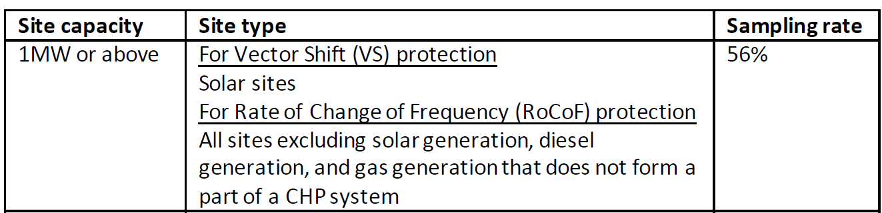
Submission of Evidence
Evidence should be sent to the DNO by email and include;
Timestamped photographic evidence showing the LoM protection device and its settings both prior to and after the change
Timestamped photographic evidence of any other relevant works on site (eg disconnected tripping circuits etc)
Printouts, screenshots or other details of protection device settings or setting files
Records of tests undertaken and/or any associated test certificates
Where possible attachments containing evidence should be named to indicate what they contain, photos should be limited the requirements above and can be incorporated into the ALoMCP proforma for ease.
Sample Site Visits (SSV)
Requirements concerning the number of SSVs to be completed and what should take place during the visit are detailed in the Delivery Assurance Policy. For example;

Slide 10
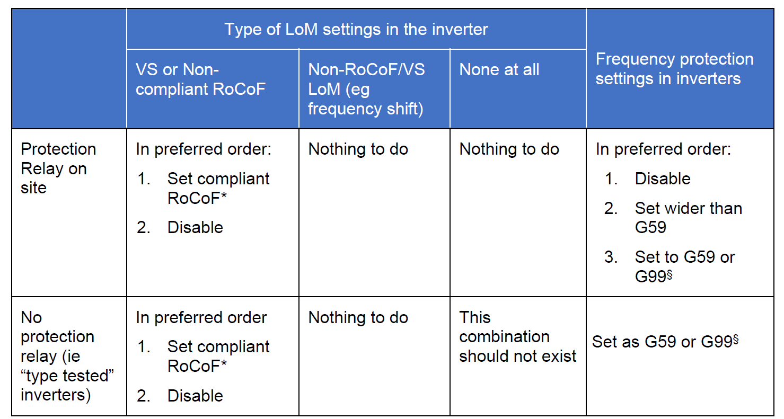
Technical queries
Relay Replacement Funding
Window 1 included applications for relay replacement where disablement of LoM Protection expected, ie on non synchronous or doubly fed induction generation units.
Relay replacement not funded for these sites on applications made from 01/02/2020.
Inverters
Changes to inverter settings may be required
Evidence proforma includes Inverter information
Inverter manufacturers contacted, open letter published on ENA ALoMCP Page here
If in doubt…
Technical FAQ
Updated regularly on ENA ALoMCP Page here

Slide 11
Inverters:
Manufacturer | Status
ABB | ABB state that their inverters do not use RoCoF or VS loss of mains. ALoMCP believes there is no adjustment to make on ABB inverters. It is the owner’s responsibility to confirm this. ABB have published this information and a list of their inverter types.
AEI | No response from manufacturer
Danfoss | Taken over by SMA. Awaiting SMA information.
Enercon | State that inverters do not use VS or RoCoF. However many (but not all) Enercon devices have a separate relay which provides LoM functions and will need to confirmed compliant and/ or reset by a competent person. Enercon can be contacted to advise on what is required at each installation.
Fronius | Fronius inverters do not use RoCoF or VS loss of mains. ALoMCP believes there is no adjustment to make on Fronius inverters. It is the owner’s responsibility to confirm this.
Ginlong (Solis) | Ginlong inverters do not use RoCoF or VS loss of mains. ALoMCP believes there is no adjustment to make on Ginlong inverters. It is the owner’s responsibility to confirm this. Ginlong have published this information.
Goodwe | Awaiting information from manufacturer
Growatt | Awaiting information from manufacturer
Huawei | Huawei confirm that RoCoF switched off by default, and no VS. Owners will need to confirm that RoCoF remains switch off, or is set to correct values. Waiting to be confirmed by Huawei
Power Electronics | The manufacturer has confirmed that RoCoF setting is an option, and that vector shift is not used. All units for GB are thought to have been shipped with RoCoF set to off. The manufacturer has confirmed that it is possible to confirm on site by interrogating the inverter – please contact the manufacturer for details. It is the owner’s responsibility to confirm the compliance of these inverters with G59.
Power One Aurora | Taken over by ABB – but not yet included in ABB information.
Refusol | No response from manufacturer
Schneider | Awaiting response from manufacturer
Siemens | Awaiting response from manufacturer
SMA | SMA states that its inverters have not used RoCoF or VS loss for of mains. Some SMA badged inverters (originally made by Danfoss) do have RoCoF settings. Currently awaiting further information from SMA. ALoMCP believes there is no adjustment to make on SMA inverters (apart from the ex-Danfoss models). It is the owner’s responsibility to confirm this. SMA have provided relevant information for owners of SMA inverters here.
Solar Edge | SolarEdge photovoltaic inverters connected under G59 do need to be updated with new settings. This can be done by the original installer or any SolarEdge agent. SolarEdge will be contacting owners of affected equipment about these changes. Domestic type inverters connected under G83 are not affected by the programme and need no changes
Solarmax | No response from manufacturer
Sungrow | No response from manufacturer
Sunways | Models NT10000, 11000, 12000 EU should be set by default to GB in which case RoCoF and VS settings are believed to be deactivated. It is the owner’s responsibility to confirm this.
Tesla | TBC
Zeversolar | Zeversolar is owned/managed by SMA. SMA states that Zeversolar inverters have not used RoCoF or VS loss for of mains.

Slide 12
Resources
Two key websites:
The Portal https://www.ena-eng.org/ALoMCP/
A detailed user guide for how to complete the information requested in the portal
A general guide to the overall Programme
A blank copy of the evidence proforma (which needs to be returned to claim payment)
A technical FAQ
Information on inverters
Information for contractors etc providing services to multiple sites/owners
The Programme webpage https://www.energynetworks.org/electricity/engineering/accelerated-loss-of-mains-change-programme.html
This contains key formal documentation:
A copy of the formal terms and conditions for participating in the Programme
Payment Process Specification
Eligibility and process
Delivery Assurance Policy
Evidence of compliance and its assessment
NGESO’s Procurement Methodology and Programme Reports
Procedural and Technical FAQs
Registered DNO | Initial Email address
Electricity North West Ltd | ALoMCP@enwl.co.uk
Northern Powergrid | G59protectionsettings@northernpowergrid.com
Scottish & Southern Electricity Networks | G59protectionsettings@sse.com
SP Energy Networks | G59protectionsettings@spenergynetworks.co.uk
UK Power Networks | G59protectionsettings@ukpowernetworks.co.uk
Western Power Distribution | ALoMCP@westernpower.co.uk
Registered IDNO | Initial Email address
Eclipse Power Networks Limited | enquiries@eclipsepower.co.uk
Energetics Electricity Limited | electricityinfo@energetics-uk.com
Energy Assets Networks Limited | controlEAN@EnergyAssets.co.uk
ESP Electricity Limited | ESPEGeneration@espug.com
Fulcrum Electricity Assets Limited | enquiries@fulcrum.co.uk
GTC | G59protectionsettings@gtc-uk.co.uk
Harlaxton Energy Networks Limited | info@harlaxtonenergynetworks.com
Independent Power Networks Limited | G59protectionsettings@gtc-uk.co.uk
Leep Electricity Networks Limited | REllison@leeputilities.co.uk
Murphy Power Distribution Limited | mail@murphygroup.co.uk
The Electricity Network Company Limited | G59protectionsettings@gtc-uk.co.uk
UK Power Distribution Limited | newconnections@ukpowerdistribution.co.uk
Utility Assets Limited | enquiries@utilityassets.co.uk
Vattenfall Networks Limited | UK-networks@vattenfall.com

Slide 13
Current Timetable
Event | Deadlines
Webinar | 27 March 2020
Application deadline for window 3 | 12 May
DNO Verification checks | 26 May
NGESO Assessment | 09 June
DNO notify Applicants | 23 June
Applicants confirm terms | + 10 days after receiving notification from DNO
Note: All dates are subject to review and confirmation in light of the current Coronavirus pandemic

Slide 14
Thank you for joining our webinar
Programme website | https://www.energynetworks.org/electricity/engineering/accelerated-loss-of-mains-change-programme.html
Application portal | http://www.ena-eng.org/ALoMCP

