Slide 1

Electrical safety and sustainability
Lesson 1

Slide 2
Learning outcomes
Identify appliances that use batteries or mains electricity
Describe and demonstrate how to use electricity safely
Explain the importance of saving electricity, and ways to do this
We will be able to:

Slide 3
What do you know about electricity?
Write or draw anything you know about electricity.
Notes:
Teacher notes
Pupils should only spend a couple of minutes on this activity, and do it individually.

Slide 4
How does it work?
Click on the things which use electricity.
How many can you identify?

Slide 5
How does it work?
How many did you get?
Uses electricity
Doesn’t use electricity
Can you list more things which use electricity, in school or at home?

Slide 6
What kind of electricity does it use?
Mains electricity comes from a plug socket.
Batteries are made up of cells which store electricity.
Do these things use the mains or batteries?
Notes:
Teacher notes
You may want to point out that mains electricity is a way of charging appliances, in the same way that we use it to charge the batteries in mobile phones, laptops etc.

Slide 7
Heat, light, sound movement
Electricity can be turned into:
Heat
Light
Sound
Movement
Notes:
Teacher notes
This slide introduces pupil worksheet 1.

Slide 8

What do they need to work?
Heat, Light, Sound, Movement
What does electricity need to be turned into for these objects to work? (Some might have more than one answer).
Heat
Light
Sound
Movement

Slide 9
Electrical safety
What do you already know about staying safe around electricity?

Slide 10
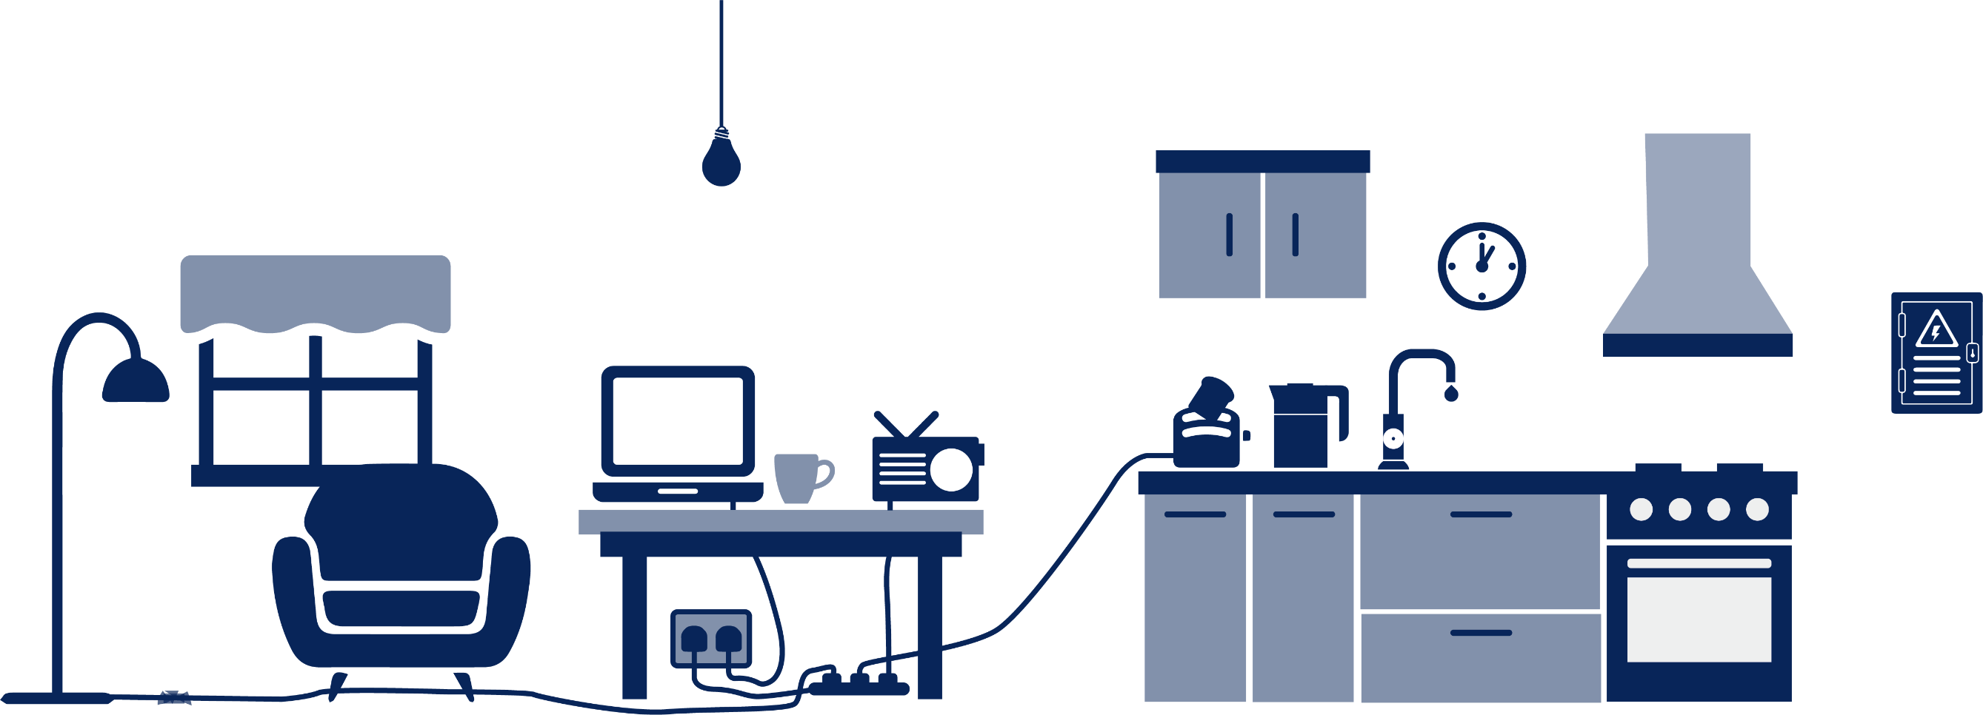

Electrical safety indoors
Lightbulbs: Ask an adult to help replace a blown lightbulb.
Adaptor overload: Plugging too many things into the same socket or adding too many extension leads can be dangerous.
Toasters: If something is stuck in a toaster, always turn it off and unplug before trying to get it out. Never use a metal object to help!
Drinks and liquids: Liquid and electricity do not mix - never put them on or near electrical objects, or use electrical objects in the bathroom.
Fuse box: Only adults should access or touch a fuse box
Damaged wire: Never use a wire that is frayed, split or wrapped in tape
Trailing leads: Leads trailing across the floor can trip you up, or the leads can get damaged and unsafe.
Sockets: Never put objects into sockets, or fingers!
Electricity and electrical equipment is very dangerous if not handled correctly. Always have an adult with you when using electricity or electrical equipment.

Slide 11
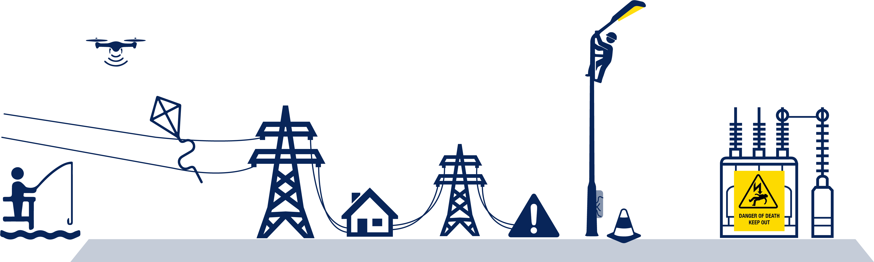
Electrical safety outdoors
Overhead wires: Look out for overhead wires before doing activities like fishing or flying a kite. If your kite or line gets tangled in the wire, it can give you an electric shock.
Kite, drone or model aircraft: Only fly these in an area where there are no overhead wires. Electricity can travel down the string of a kite if it gets tangled in the wires. Electricity can also 'jump' from the wires to objects like drones that get too close.
Electrical substation: Electrical substations always display a warning sign that says and means 'Danger of death'. Never play around an electrical substation, or try to enter one, no matter what. If something you own goes into a substation, ask an adult to call the electricity company for your area.
Steel towers: Steel towers mustn't be used as climbing frames!
Fishing: Never go fishing where there are overhead wires. If your line gets tangled in a wire, electricity may travel down it and give you an electric shock. Electricity can also 'jump' to objects which get too close. Electricity can travel down fishing rods made from certain materials, and down nylon line if it is wet.
Street works: When there are street works going on there may be exposed electrical wires. Stay clear of any works that are going on, and behind any protective barriers.
Warning signs: Warning signs are there for a reason! Always take notice of them and stay clear.

Slide 12

Electrical safety
Can you create something telling younger children how to stay safe around electricity?
It could be a poster, a cartoon, a presentation, a leaflet, a song, a rap, a poem…
Anything you like to help keep them safe!

Slide 13
Saving electricity
Why is it important to save electricity?
To save money
To save the planet!
Find out more:
What is renewable and non-renewable energy?
https://www.bbc.co.uk/bitesize/topics/zp22pv4/articles/ztxwqty
Fossil Fuels and Renewable Energy https://www.bbc.co.uk/bitesize/topics/zshp34j/articles/zntxgwx

Slide 14
Saving electricity card sort
Saves electricity
Doesn’t save electricity
Switch lights off when leaving a room
Use energy saving light bulbs
Take a shorter shower
Turn plug sockets off when they are not being used
Make sure a dishwasher is full before turning it on
Leave a mobile phone charging overnight
Do three loads of washing a day
Fill up the kettle every time you use it
Leave the hot tap running while washing up or washing hands
Can you think of one more of your own?

Slide 15
Clean sources of energy
Create a renewable energy fact file about one or more of these clean energy sources.
Which one would you score the highest?
Solar energy
Wind turbines
Tidal energy
Hydroelectricity

Slide 16
Rechargeable devices
Wind up torch
Solar panel mobile charger
Batteries
Low carbon technologies electric car

Slide 17
What do you know about electricity?
Write or draw anything more you know about electricity now.
Notes:
Teacher notes
This is an optional slide which can be used at the end of this lesson, or the series of lessons.

