Slide 1

How does electricity work?
Building electrical circuits
Lesson 2

Slide 2

Learning outcomes
Use electricity to make something heat or light up, move or make a noise
Make a simple circuit
Draw a simple circuit using electrical symbols
We will be able to:

Slide 3
Recap: What do you know about electricity?
Name three everyday things/things in this room which use electricity
How do we know if something uses electricity?
What is the difference between mains electricity and batteries?
What are three ways of staying safe around electricity indoors?
What are two ways of staying safe around electricity outdoors?
What four things can electricity be turned into?
Notes:
Teacher notes
Use these questions to recap on the previous lesson and check for any gaps in understanding. Questions can be changed to suit the class/your needs if necessary.

Slide 4
How does electricity make things work?
Remember: electricity can be turned into:
Heat
Light
Sound
Movement
Can you think of an example for each one of these?

Slide 5
Build an electrical circuit
Wires
Bulb
Buzzer
Motor
Cell
Crocodile clips
Notes:
Teacher notes
If pupils are working at home, or if there are limited resources, they can use Worksheet 1 to cut out the components and experiment with fitting them together. They can also do this once they have learned about creating an unbroken circuit to see what this looks like.

Slide 6
Build an electrical circuit
What do you need to do for the bulb to light up?
For the bulb to light up, the circuit must be…
The electricity should be able to…
If the circuit is broken it…
Notes:
Teacher notes
Challenge pupils to complete the sentences, or include a sentence of your own so that they come to the conclusion that a circuit must be complete for the electricity to flow around it and the bulb to light.

Slide 7


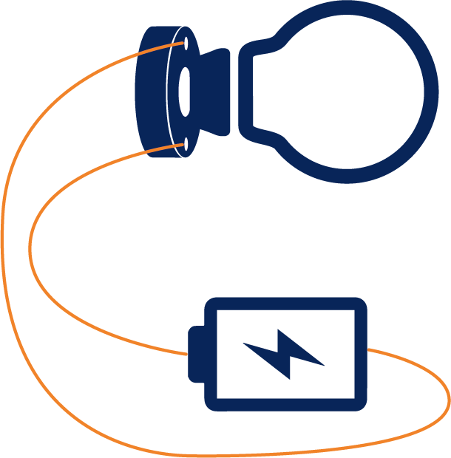



Will it, won’t it?
Will the bulb light up?
Notes:
Teacher notes
Worksheet 1 accompanies this slide.

Slide 8
Will it, won’t it?
Will the bulb light up?
Notes:
Teacher notes
Worksheet 1 accompanies this slide.

Slide 9
Electrical symbols
Two 1.5V cells connected together = 3V battery
1 cell battery = 1.5V
Bulb
Motor
M
Bell
Connecting wire

Slide 10
What have we learnt today?
Which four things can electricity be turned into into?
Heat, light, movement and sound
For something to work using electricity, you need to make a…
Circuit
For a bulb to light up, a circuit needs to be…
Unbroken or complete
To draw a circuit, we use electrical…
Symbols
Notes:
Teacher notes
You can change or add your own quiz questions if required.

